Slide 1
EANS Training – STC
ESCAPE STORIA
Philippe BOUCHAUDON
ATM Simulator Specialist
V1.0 28th of October 2019

Slide 2
STORIA System overview
STORIA is the Software Tool for Online Recording and Interactive Analysis.
It is composed of:
STORIA CORBA COMPONENT (SCC), responsible for the catching and recording of events occurring during the simulation in XML format,
STORIA ANALYSIS TOOL (SAT), a java portable replay and analysis software.

Slide 3
STORIA System overview
STORIA CORBA COMPONENT (SCC), is composed of two (2) CORBA components that shall be selected in the run if analysis with STORIA ANALYSIS TOOL (SAT) is expected
STORIA ANALYSIS TOOL (SAT) can be used:
During runtime for immediate analysis
After runtime if logs and/or recordings have been saved for post simulation analysis

Slide 4
STORIA System overview
The STORIA CORBA COMPONENT:
records the simulations events in XML format,
gathers the static data defining the simulation and runtime events.
The resulting xml data is compliant with a standard STORIA grammar and that can be easily used via spread sheet tools, STORIA ANALYSIS TOOL or third-party analysis tools.

Slide 5
STORIA System overview ☺
The current recordings contain:
Static data (corresponding to IPAS data):
exercise environment
AIR data (provided by AIR system)
radar tracks
pilot orders
air 4D profiles
Ground data (provided by Ground systems and Tools)
ground 4D profiles
safety nets: MTCD, STCA, APW, MTAPW
LORD events
Datalink data (provided/transmitted by Datalink system)
CPDLC events
Pilot Preference (PPDL)
RTA events

Slide 6
STORIA System overview ☹
The current recordings does NOT contain:
CWP -> Ground data
Controllers orders

Slide 7
STORIA System
This presentation will focus on:
PART 1: SCC runtime architecture
PART 2: SCC components configuration
PART 3: File format and content
PART 4: Using SAT
during runtime
After runtime
PART 5: Recommendations

Slide 8
STORIA System – Runtime architecture
OASIS
AIR System
GROUND System
STORIA
EATG Manager
Datasets
PWP
EATG
ASAS
P4d
PWP
EATG
PPD
AceSTO1
IPAS Files
Datalink
AceSTO2
CWP System
GROUND Tools
STCA
MTCD
CWP
APW
MTAPW
AMAN
LORD

Slide 9
STORIA System
This presentation will focus on:
PART 1: SCC runtime architecture
PART 2: SCC components configuration
PART 3: File format and content
PART 4: Using SAT
during runtime
After runtime
PART 5: Recommendations

Slide 10
STORIA System – Runtime components
OASIS
AIR System
GROUND System
STORIA
EATG Manager
Datasets
PWP
EATG
ASAS
P4d
PWP
EATG
PPD
AceSTO1
IPAS Files
Datalink
AceSTO2
CWP System
GROUND Tools
STCA
MTCD
CWP
APW
MTAPW
AMAN
LORD

Slide 11
STORIA System – Runtime configuration
Two recordings components but one configuration file: storia.config
Default values shall be used

Slide 12
STORIA System – Runtime components
Two recordings components generating 2 XML files
AceSTO1 records:
Copy of IPAS data
AIR data:
State vectors provided by EATG
Flights assignments provided by EATG Manager
Pilots orders
ASAS orders
Simulation Events:
Unfreeze / Freeze
Pilots Preferences are considered as “downlinked” data, thus recorded by AceSTO2
Timer speed is not recorded

Slide 13
STORIA System – Runtime components
Two recordings components generating 2 XML files
AceSTO2 records:
Ground 4D trajectories
Ground Tools events
STCA, MTCD, APW, MTAPW
LORD
AMAN
Datalink exchanges
Uplink and Downlinks
Pilots Preferences (as considered as downlinked data)
Controllers orders are NOT recorded

Slide 14
STORIA System
This presentation will focus on:
PART 1: SCC runtime architecture
PART 2: SCC components configuration
PART 3: File format and content
PART 4: Using SAT
during runtime
After runtime
PART 5: Recommendations

Slide 15
STORIA System – Generated files - Name
Two recordings components generating 2 XML files
File naming:
AceSTO1_<SimuName>_<ConfigName>.xml
AceSTO2_<SimuName>_<ConfigName>.xml
Example:
AceSTO1_EANS_UP1.xml
Where:
Simulation Name is EANS
Configuration Name is UP1

Slide 16
STORIA System – Generated files - Runtime
File location
During runtime:
On the server running AceSTO1 and AceSTO2
/home/runesc/<SimuName>_<EscapeUser>/<RunName>/runtime/<ConfigName>
Example:
/home/runesc/EANS_eans/Run_UPPER/runtime/UP1
Where:
Simulation Name is EANS
ESCAPE User is eans
Run Name is Run_UPPER
Configuration Name is UP1

Slide 17
STORIA System – Generated files - Recordings
File location
Recordings (offline analysis):
On a server having access to the recordings (all servers)
/exercises/bach/<SimuName>/recording/ground/<Exercise>_<YYMMDD>_<HHMMMSS>
Example:
/exercises/bach/EANS/recording/ground/UPPER_191024_100837
Where:
Simulation Name is EANS
Exercise is UPPER
Date of run is 24th of October 2019
Time of run is 10:08:37

Slide 18
STORIA System – Generated files – Logs 1/2
File location
Logs (offline analysis):
On a server having access to the logs (all servers)
/exercises/tracesandlogs/<SimuName>/<SaveDir>/<Server>/runtime/<ConfigName>
Example:
/exercises/tracesandlogs/EANS/savedLogs_UPPER_190923_170453/srv01/runtime/UP1
Where:
Simulation Name is EANS
Server Name is srv01
Configuration Name is UP1

Slide 19
STORIA System – Generated files – Logs 2/2
Example:
/exercises/tracesandlogs/EANS/savedLogs_UPPER_190923_170453/srv01/runtime/UP1
Default <SaveDir> is composed of:
savedLogs prefix
Name of the exercise
Date of the run
Time of the run
Default <SaveDir> can be fully or partly changed is the save logs process
We recommend to use the default values + an user suffix

Slide 20
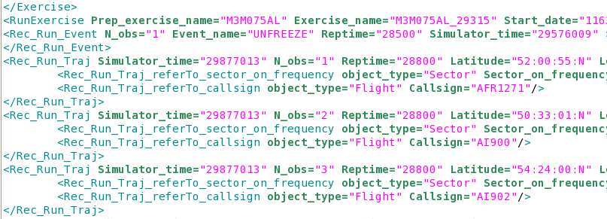
STORIA System – Generated files – Format
The XML format is based on ASCII representation, thus Human Readable using a standard editor. Nevertheless, nothing compared to using SAT.

Slide 21
STORIA System
This presentation will focus on:
PART 1: SCC runtime architecture
PART 2: SCC components configuration
PART 3: File format and content
PART 4: Using SAT
during runtime
After runtime
PART 5: Recommendations

Slide 22
STORIA System – Starting SAT
From the main server:
Or using an alias:
[runesc@findos ~]$ cd /exercises/bach/EANS/escape/SAT
[runesc@findos SAT]$ ./sat.sh
MESSAGE - [main] - Reading resources from sat/resources/sat_common.gsdk...
MESSAGE - [main] - Reading resources from atcapp/resources/common/graphics/physicalColours.gsdk...
…
[runesc@findos ~]$ alias sat19a='cd /exercises/bach/EANS/escape/SAT/; ./sat.sh‘
[runesc@findos ~]$ sat19a
MESSAGE - [main] - Reading resources from sat/resources/sat_common.gsdk...
MESSAGE - [main] - Reading resources from
…

Slide 23
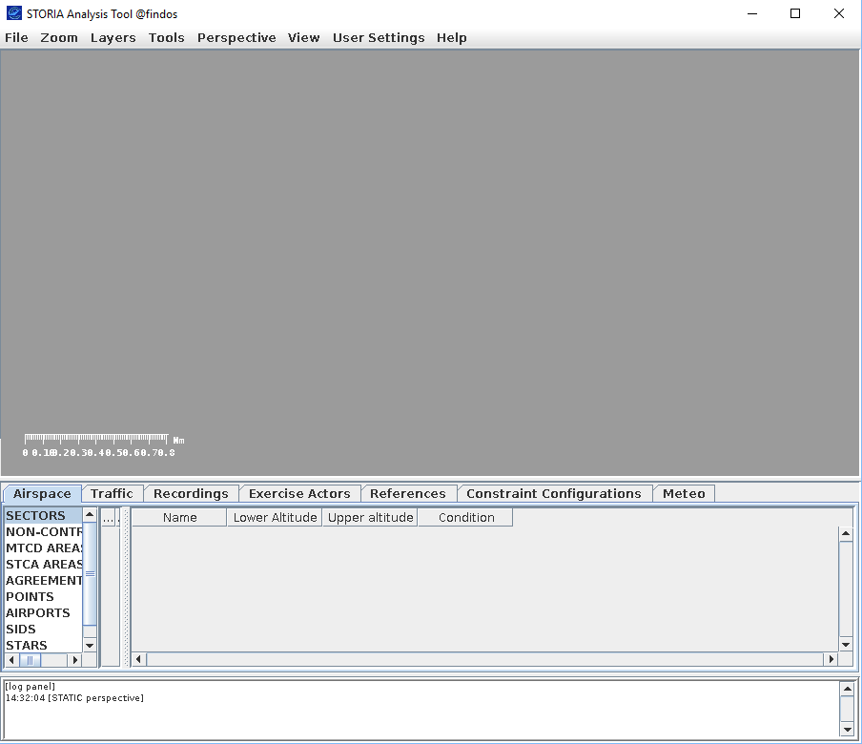
STORIA System – Starting SAT
It gives access to the following tool (check that DISPLAY is set)

Slide 24
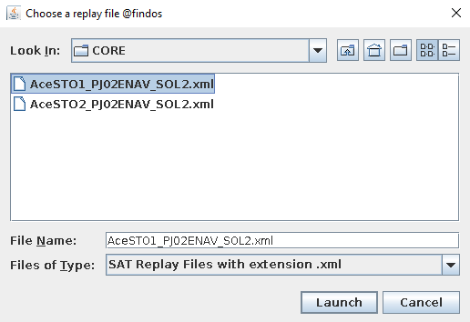
STORIA System – Starting SAT
Using File menu, the XML can be loaded
Select one of the xml file and click on “Launch” button

Slide 25
STORIA System – Using SAT – Pilot orders

Slide 26
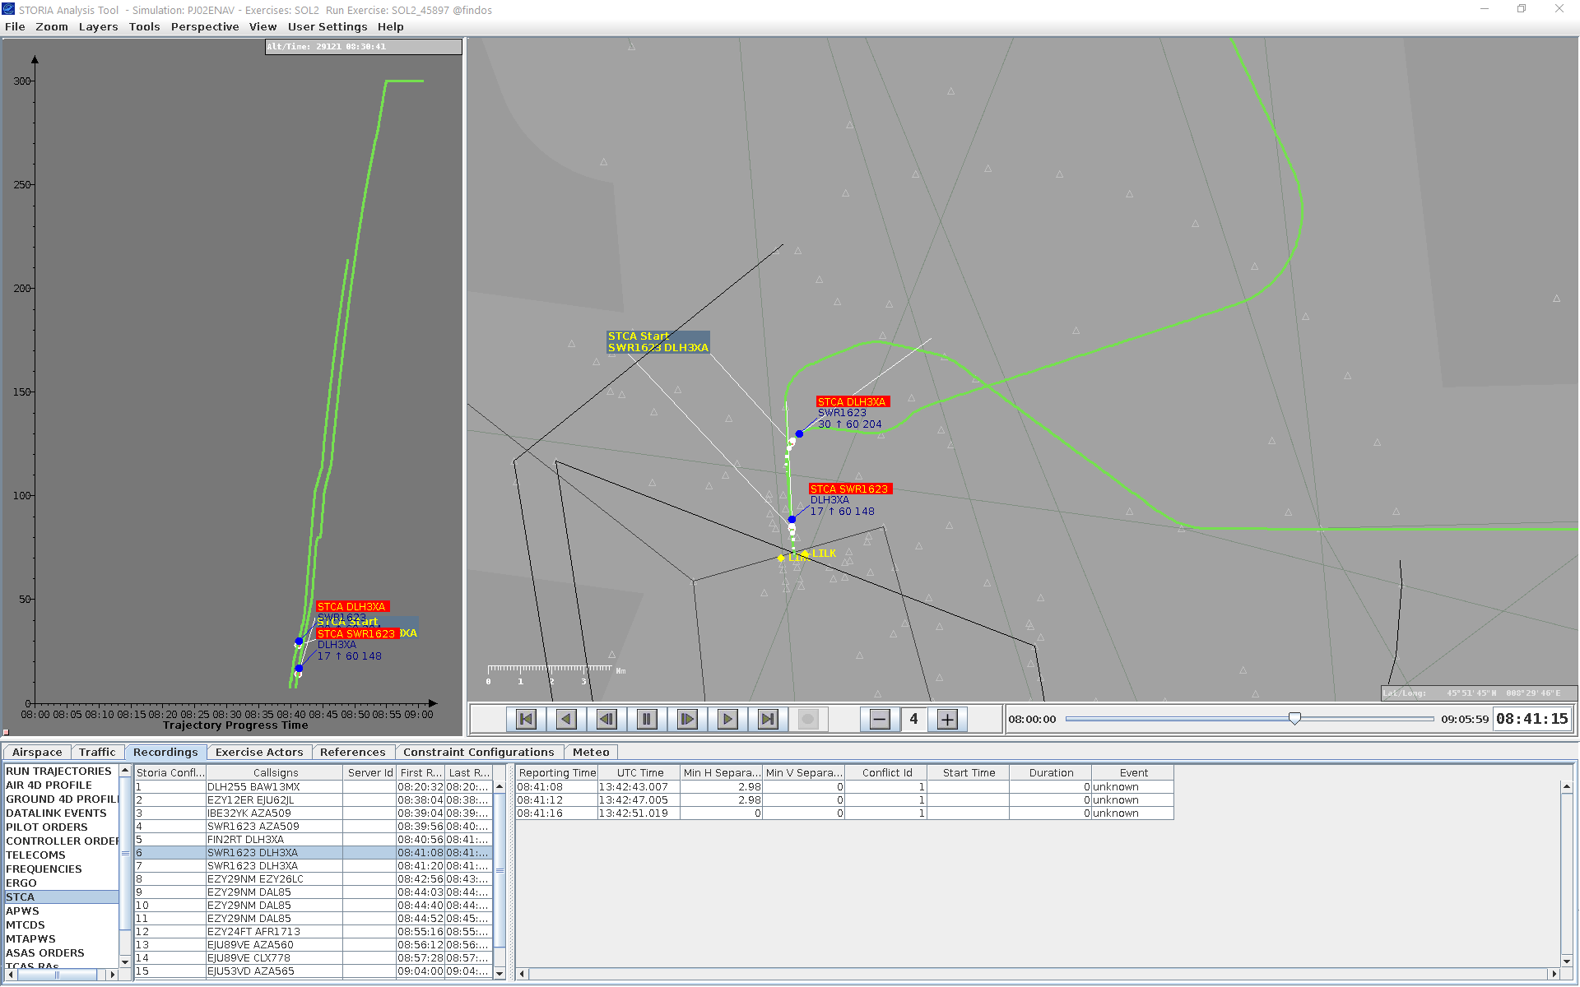
STORIA System – Using SAT – STCA in replay

Slide 27
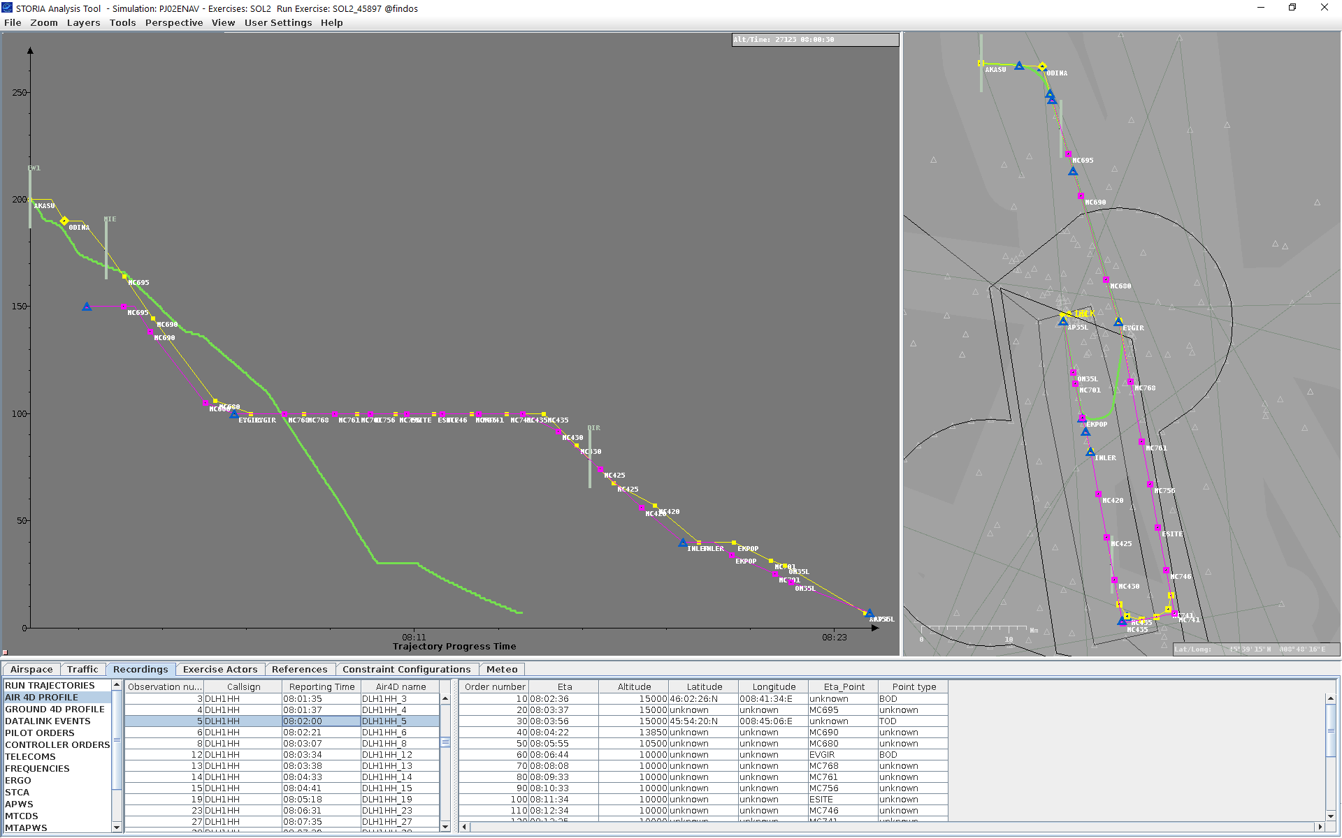
STORIA System – Using SAT – AIR vs GRD 4D

Slide 28
STORIA System – Using SAT
No need for a ModOp – A live demo is better
Notes:
Guidelines for the live demo:
Starting SAT (SAT PJ02ENAV shall be launched)
Loading files
Menu review:
Focus on File Open/Exit
Zoom
View
Perspective
Panel review
Radar,
Vertical
Approach
Zoom and Excentering
Table review
Data from IPAS (Airspace, Traffic, Actors; Reference, Constraint, Meteo (not detailed))
Data from runtime (Recordings)
Run Trajectories DLH1HH
AIR 4D
Pilot Orders
STCA SWR1623 / DLH3XA in replay view

Slide 29
STORIA System
This presentation will focus on:
PART 1: SCC runtime architecture
PART 2: SCC components configuration
PART 3: File format and content
PART 4: Using SAT
during runtime
After runtime
PART 5: Recommendations

Slide 30
STORIA System – Recommendation
It is highly recommended to use STORIA
It will be required:
For all analysis that EANS plans to do
In case support is needed from EEC:
Logs and STORIA recordings are mandatory

