Slide 1
ESCAPE Training – STC
ESCAPE Exercise Delivery and Installation (ACE2019A)
Philippe BOUCHAUDON
ATM Simulator Specialist
Created: 24th of January 2020
Last update: V1.1 7th of October 2020
Notes:
V1.0 Training relying on ACE2016A
V1.1 Adaptation to ACE2019A

Slide 2
ESCAPE Exercise D&I - Forewords
This slideshow corresponds to the link between data preparation and runtime.
It is considered:
Exercise has been correctly prepared:
Airspace has been checked using ART Visu
Profiles have been checked using PVT Interactive
Traffic has been checked using ART Analysis
The following directory shall be available on IPAS server
Exercise delivery area: /exercises/bach
The following directories shall be available on GROUND server
Exercise delivery area: /exercises/bach
Installation area: /exercises/prepesc

Slide 3
ESCAPE Exercise D&I - Forewords
This slideshow corresponds to the link between data preparation and execution in runtime.
Part 1 – Using IPAS – Exercise Delivery:
Exercise checking and delivering – “Check and Deliver”
Ground Profile computation – “PVT Batch”
Optional Air data compiling – “AIR Prep”
Part 2 – Using “run_escape” on ground (main) server – Exercise Installation
Exercise installation

Slide 4
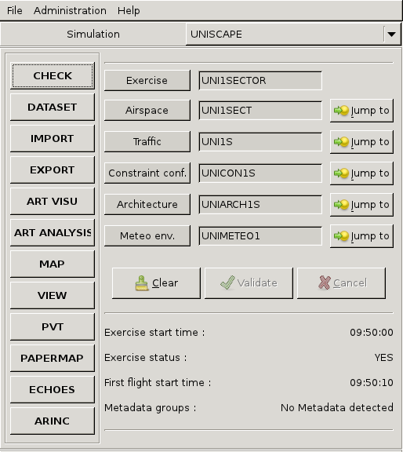
ESCAPE Exercise Delivery – Check and Deliver
From IPAS:
Open the “Check” tool

Slide 5
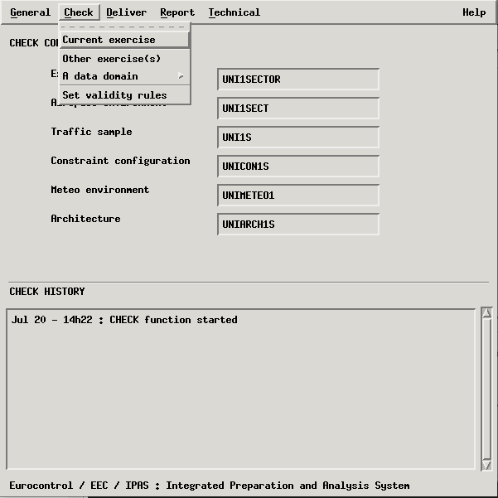
ESCAPE Exercise Delivery - Check
From “Check” tool:
Select “Check” then “Current exercise”
Check for reported warnings and errors

Slide 6
ESCAPE Exercise Delivery - Deliver
From “Check” tool:
Select “Deliver” then “Current exercise”
Check for reported warnings and errors
The “Check” tool can be closed

Slide 7
ESCAPE Exercise Delivery – PVT
From IPAS:
Open the “PVT” tool

Slide 8
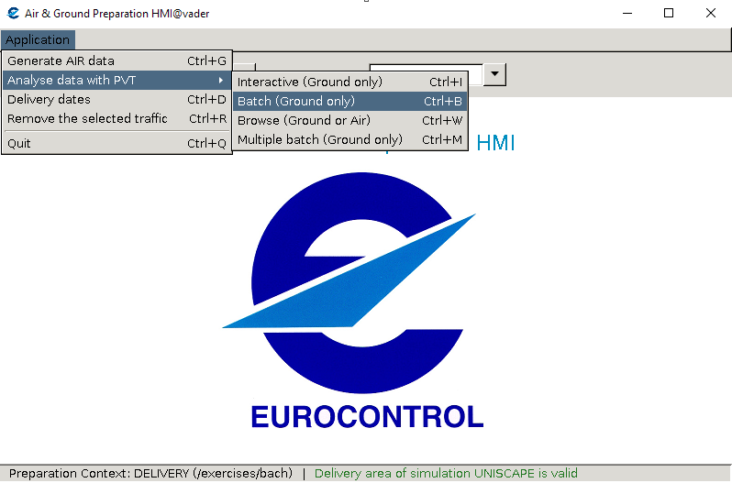
ESCAPE Exercise Delivery – PVT Batch
From “PVT” tool:
Select “Analyse data with PVT” then “Batch (Ground only)”

Slide 9
ESCAPE Exercise Delivery - PVT Batch
Click on “Start” button

Slide 10
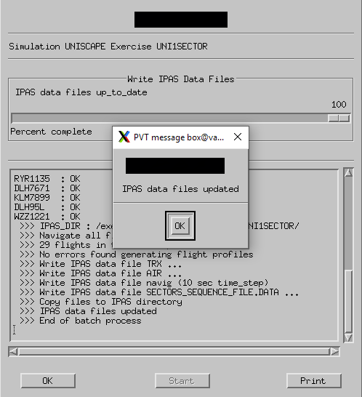
ESCAPE Exercise Delivery - PVT Batch
Check for warnings or errors

Slide 11
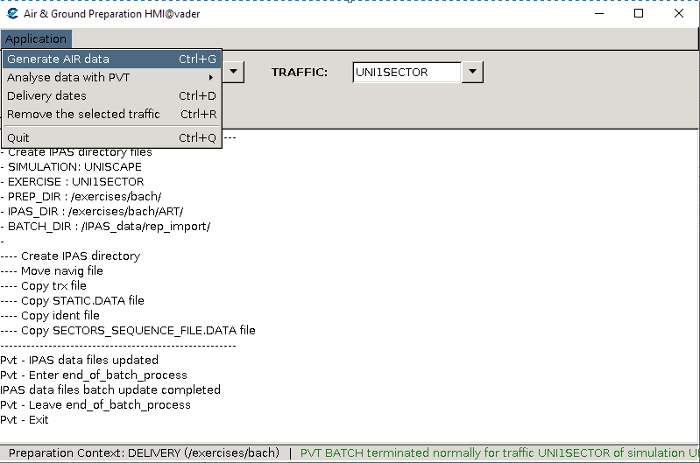
ESCAPE Exercise Delivery – AIR Preparation
Optional Step (additional data checking)
From “PVT” tool:
Select “Generate AIR data”

Slide 12
ESCAPE Exercise Installation
Main challenge of exercise installation is:
a copy
from the “exercise delivery area” (/exercises/bach)
to the “installation area” (/exercises/prepesc)
The compilation of a set a file to reduce the platform starting time (named “air preparation”)
The installation of the exercise is done using the “ESCAPE supervision” tool.

Slide 13
ESCAPE Exercise Installation - Supervision
Second step is the execution of the ESCAPE supervision tool !
On the ground server:
An alias has been created to ease the launching: “l”
[runesc@empgrd01 ~]$ l

Slide 14
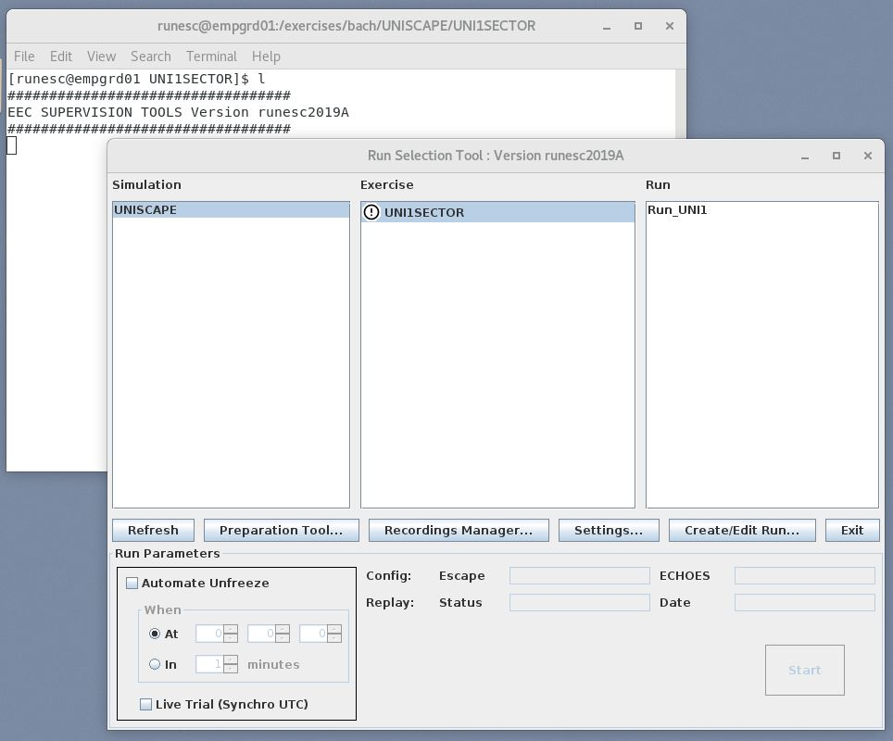
ESCAPE Exercise Installation - Supervision
If an exercise has been
delivered, a marker will
be added before the
exercise name:

Slide 15
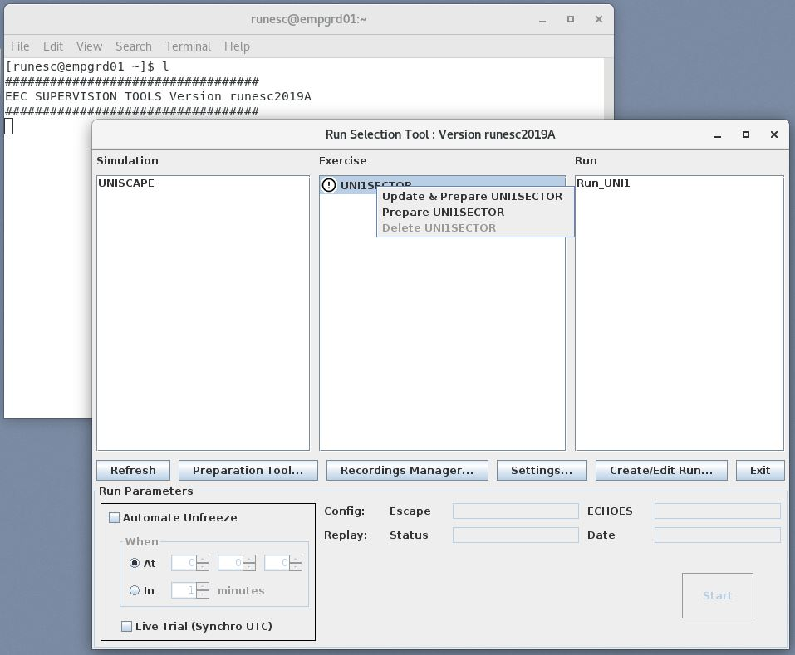
ESCAPE Exercise Installation - Supervision
A right click on the exercise name will popup a menu:
The “Update and Prepare” option shall be selected

Slide 16
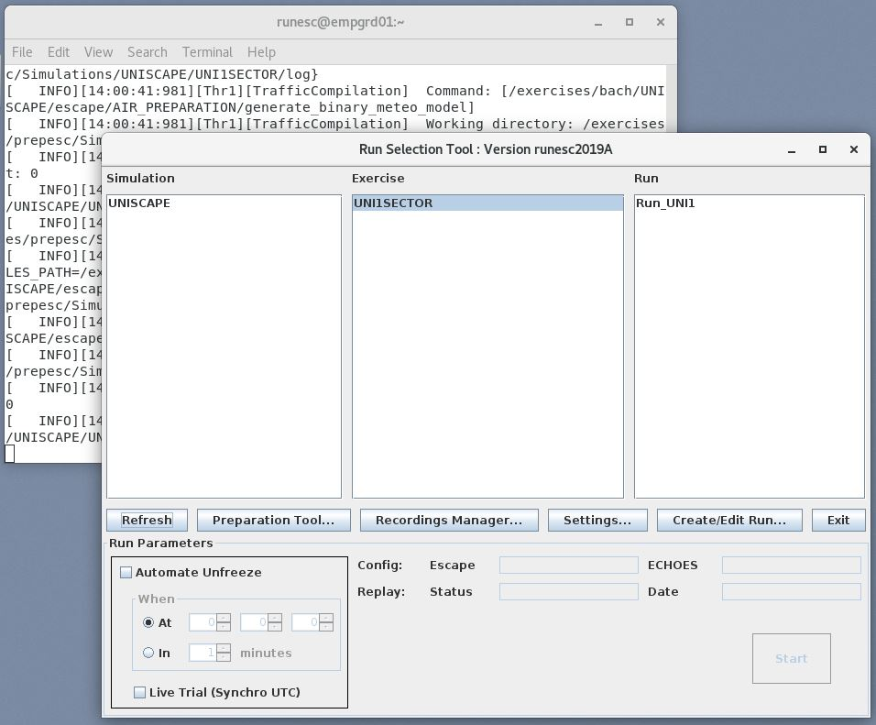
ESCAPE Exercise Installation - Supervision
Once done, the marker is removed.

Slide 17
ESCAPE Exercise Installation - Supervision
In the launching terminal, if required, you can check that compilation result is 0.
In case of problem check the log file name indicated.

Slide 18
ESCAPE Exercise Delivery and Installation
Thank you for using ESCAPE
Any questions?

