Slide 1
ESCAPE Training – STC and IPAS
ESCAPE Data Flow
Philippe BOUCHAUDON
ATM Simulator Specialist
Created: V2.0 10th of October 2019
Last Update: V2.2 20th of July 2020
Notes:
V1,0 Initial version
V2,0 Complete redesign after presentation 07th of October
V2,1 Review

Slide 2
ESCAPE Data Flow - Overview
Using ESCAPE means:
A set of machines linked over a network
Each of these machines:
Have particular role based on hardware definition
Processor / RAM / Graphical Card / Display
Contains Hard drives containing
Partitions / File System
Directories / Binaries and data
Objective of this presentation is to identify:
ESCAPE file system principles
Where are the data?
What is local and what is shared?
In few words, the data location and the data flow

Slide 3
ESCAPE IT
ESCAPE Preparation and Runtime hardware is composed of:
Preparation (IPAS) computer(s)
Runtime Server(s) (Ground and AIR)
Pilot Working Positions (PWP)
Controller Working Positions (CWP)
Each of these computers owns local hard drives and data partitions which can be:
Local – Accessible only when logged on computer
Shared – Accessible from any computer
Shared file systems will be physically located on the main Ground runtime server.
Oracle database will be physically located on a dedicated server (optionally on IPAS server)

Slide 4
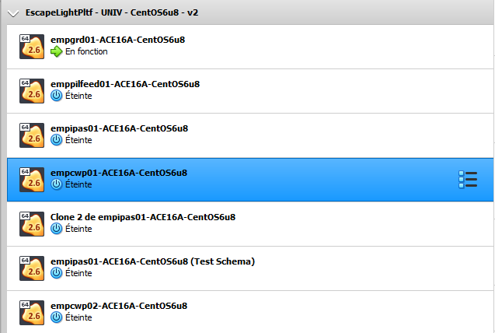
ESCAPE Light – Using VirtualBox
Using ESCAPE Light under VirtualBox
The notion of “physical machines” is replaced by the notion of “Virtual machines”
As for any physical machines, a virtual machine is composed of:
CPU / RAM / Graphical Card / Connected display
Network capabilities
Disks and data partitions
…

Slide 5
ESCAPE dataflow IT
Shared DB
Local data
Shareddata
Oracle XE DB
CWP
CWP
Delivery Installation Logs
GRD
GRD
IPAS
PWP
IPAS
PWP

Slide 6
ESCAPE dataflow
Preparation
Analysis
Delivery
Runtime
Installation

Slide 7
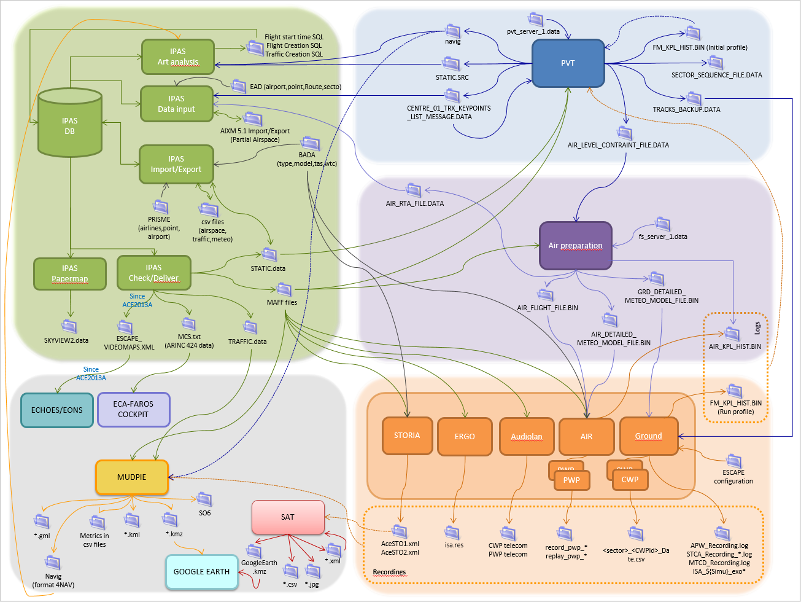
ESCAPE dataflow simplified view
Preparation area
Delivery area
Analysis area
Installation area
Runtime area

Slide 8
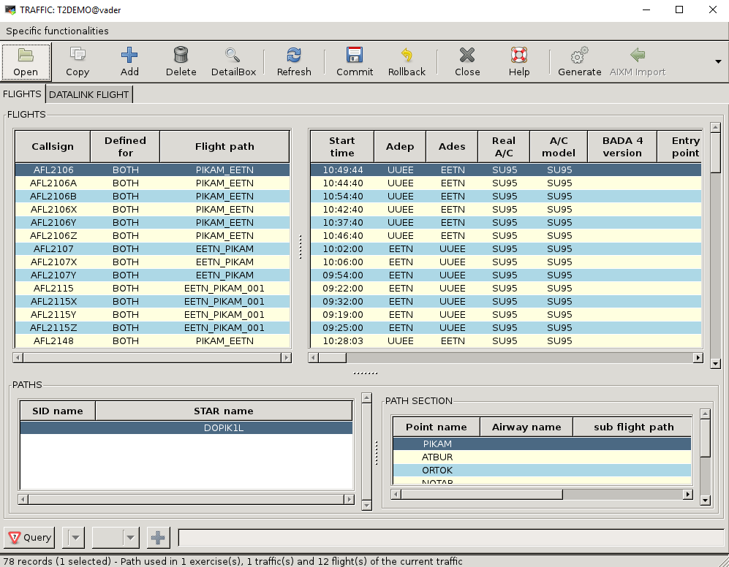
ESCAPE Preparation area
Preparation
The ESCAPE Preparation area is composed of:
1 Oracle DB containing all data under preparation
Accessed via IPAS tool
Local area containing:
IPAS binaries
IPAS configuration files
Import / Export files
BADA files
Geographical maps (borders)
Maps

Slide 9
ESCAPE Delivery area
Preparation
Delivery
Link between data preparation and STC
The delivery area is composed of a shared area /exercises/bach
The delivery area contains
Preparation tools
Delivered exercises
BADA files
The delivery area also contains
Recordings
Analysis tools
/exercises
bach
BADA
<Simulation1>
escape
AIR_PREPARATION
PVT
SAT
ECHOES_LIGHT
ECHOES_LIGHT_CFG
EONS
recording
<Exercise1>
<Exercise2>

Slide 10
ESCAPE Installation area
Preparation
Delivery
Installation
The installation area is composed of:
A shared area
/exercises/prepesc
Local area on each servers, PWP and CWP: “Full Deployment”
/home/runesc

Slide 11
ESCAPE Installation shared area
Preparation
Delivery
Installation
The installation shared area contains
ESCAPE common area:
ESCAPE installation tool (run_escape)
ESCAPE Supervision (launch_spv)
ESCAPE platform description file
HMI (CWP) fonts
ESCAPE simulation area:
1 directory per simulation
Simulation platform description file
ESCAPE binaries
Installed exercises
ESCAPE Software Configurations
/exercises
prepesc
escape
Simulations
<Simulation1>
appli
config
GRD
…
<Exercise1>
<Exercise1>
<Simulation2>
ESCAPE_HMI_FONTS

Slide 12
ESCAPE Installation shared area - Configuration
Preparation
Delivery
Installation
Focus on Software Configuration
Each component is delivered with its default configurations files
Ground
CWP
STORIA
AIR EATG and PWP
These configurations files must be copied together and customized according to simulation needs
Several ESCAPE configurations can be prepared
/exercises
prepesc
escape
Simulations
<Simulation1>
appli
config
Config 1
Config 2
…
GRD
config
CWP
Config
STORIA
config
AIR
EATG
config
PWP
config
<Simulation2>

Slide 13
ESCAPE Installation local area
Preparation
Delivery
Installation
The installation local area contains
For each simulation, a set of binaries replicated on all hosts part of the system
Controller Working Position binaries
Pilot Working Position binaries
OASIS (middleware) binaries
This copy of binaries locally on positions was formerly named “Full Deployment”
/home/runesc
<Simulation1>_COMMON
EONS
OASIS
PWP
<Simulation2>_COMMON

Slide 14
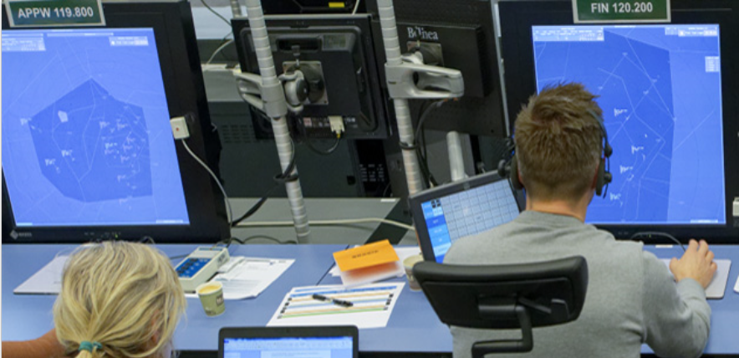
ESCAPE Runtime area
Preparation
Delivery
Runtime
Installation
The Runtime area is composed of:
The installation shared area
/exercises/prepesc
Local area on each servers, PWP and CWP: “Light Deployment”
/home/runesc

Slide 15
ESCAPE Runtime local area
Preparation
Delivery
Runtime
Installation
ESCAPE Runtime local area:
One area per simulation, ESCAPE user and run
Replicated on all hosts defined as PWP and CWP
The copy of the configuration files
Links to binaries
Runtime Logs and recordings
This run deployment locally on positions was formerly named “Light Deployment”
/home/runesc
<Simulation1>_<ESC_User1>
<Run1>
config
exec
idl
lib
log
oasis
run
runtime
<Run2>
<Simulation2>_<ESC_User2>

Slide 16
ESCAPE Runtime local area (main server)
Preparation
Delivery
Runtime
Installation
ESCAPE Runtime local area (main server):
Main server is the “Ground” server
One area per ESCAPE user
ESCAPE user configurations files
ESCAPE runs descriptions
ESCAPE Supervision logs
Link to ESCAPE Supervision binaries
Token server
Token server allows several users to use the platform at the same time
Even out of EANS scope, it shall be configured
/home/runesc
ESC_Users
<ESCAPE User 1>
runs
scripts
tools
<ESCAPE User 1>
token_server

Slide 17
ESCAPE Analysis area
Preparation
Analysis
Delivery
Runtime
Installation
The Analysis area is the link between
data preparation,
STC
Analyst
The Analysis area is composed of:
3 shared area
/exercises/tracesandlogs
/exercises/bach
/exercises/screenshotsandvideos

Slide 18
ESCAPE Analysis area
Preparation
Analysis
Delivery
Runtime
Installation
The analysis area contains:
Saved logs and recordings
One area per simulation
One logs area per run instance
Saved recordings
One area per simulation
Analysis tools
PVT (Browse mode)
SAT
Saved screenshots and videos
/exercises
tracesandlogs
<Simulation1>
<Savedlogs_Run1_date1>
<Savedlogs_Run1_date2>
<Savedlogs_Run2_date1>
<Simulation2>
bach
<Simulation1>
recording
escape
PVT
SAT
<Simulation2>
screenshotsandvideos

Slide 19
To remember
Main entries
/exercises/bach/<Simulation> : delivery area, recordings and analysis area
/exercises/prepesc/ : installation and runtime area
/home/runesc/<Simulation>_COMMON : installation area
/home/runesc/<Simulation>_<Run> : runtime area
/exercises/tracesandlogs/ : analysis area
Further
/exercises/bach/BADA : performance data
/home/runesc/ESC_users/<Escape User> : user configuration data
/home/runesc/token_server : token configuration data

Slide 20
To remember
Preparation IPAS / Oracle DB
Analysis /exercises/tracesandlogs /exercises/bach
Delivery /exercises/bach
Runtime /home/runesc /exercises/prepesc
Installation /exercises/prepesc

Slide 21
ESCAPE Data Flow
Thank you for using ESCAPE
Any questions?

