Slide 1
ESCAPE Light Training – IPAS
Web Session 28th of July 2020
Philippe BOUCHAUDON
ATM Simulator Specialist
Created: 18th of March 2020
Last update: V1.1 20th of July 2020

Slide 2
IPAS System
This presentation will focus on:
IPAS Introduction
IPAS data organization
IPAS data flow
Basic IPAS functions
Data preparation with IPAS
Data validation with IPAS
Data analysis with IPAS

Slide 3
ESCAPE System overview
Notes:
On a technical point of view, ESCAPE simulator requires 3 sets of facilities:
- A set of software, the ESCAPE sub-components, implementing the simulator real time processes and allowing the simulator’s execution,
- Then a set of simulator’s configuration files, providing technical and functional parameters for the simulator execution purpose,
- And finally a set of prepared data files, previously prepared off-line with the help of Data Preparation Systems (IPAS, PVT).

Slide 4
Working process
Data Preparation Perimeter
Simulation
Preparation
Validation
Pre analysis
Post analysis
Notes:
3 main steps are necessary for the preparation of data:
- data Preparation
- with the simulation initialisation activities
- and the preparation of simulated data (airspace, traffic, etc…)
- data Validation
- IPAS exercise validation (airspace & traffic data)
- Flight profile & ATC constraints validation (PVT)
- and data Pre-analysis
- Traffic analyse & Exercise statistics on sector load (ART analysis)

Slide 5
IPAS System overview
IPAS is the Integrated data Preparation and Analysis System.
Main features:
Input, modify, and delete all data via tabular screens,
Display geographical data with graphical display facilities,
Exchange data with external sources (organism, clients, systems),
Validate data from an operational point of view: realistic traffic, sector load expected,
Check data managed by the system
Produce exercises in the format required by the target simulator,
Foresee what should be the analysis results of the simulation run (pre simulation mode),
Analyze the results of the simulation run (post simulation mode).
Notes:
IPAS (Integrated Preparation and Analysis System) is intended to carry out all the preparation and analysis work for simulations.

Slide 6
IPAS System
This presentation will focus on:
IPAS Introduction
IPAS data organization
IPAS data flow
Basic IPAS functions
Data preparation with IPAS
Data validation with IPAS
Data analysis with IPAS

Slide 7
IPAS data organization
IPAS data is grouped for a given simulation into:
Reference data:
Aircraft models
Real Aircrafts
World points
World airports
Airlines
System capacity parameters
Dynamic capacity parameters
Airports groups
Prepared data:
Airspace
Traffic
Constraint
Architecture
Meteo
Named “Domains”
Exercises

Slide 8
IPAS Domains - Airspace
Prepared data:
Airspace
Traffic
Constraint
Architecture
Meteo
Airspace domain allows to manage:
Airports including Runways,
Points of various types:
beacons, navaids, boundary points,
geographical points,
Airways, SIDs, STARs including go-around procedures,
Holding stacks,
ATC centres including available equipment (datalink),
Sectors,
Non-controlled areas (Military area, geographical area…),
Flight paths,
Aman fixes points,

Slide 9
IPAS Domains – Traffic - Constraints
Prepared data:
Airspace
Traffic
Constraint
Architecture
Meteo
Traffic domain allows to manage:
Flights
Including available datalink equipment
Constraint configuration domain allows to manage :
ATC constraints
RFL,
Intermediate level (between SID and ENROUTE…),
COP definition (currently not used *)
Green levels,
Applications rules,
Restrictions,

Slide 10
IPAS Domains – Architecture
Prepared data:
Airspace
Traffic
Constraint
Architecture
Meteo
Architecture domain allows to manage:
Controllers Working Position including type and role,
Pilot Working Position including open/closed default status,
Short Term Conflict Alert (STCA) area definition and parameters,
Medium Term Conflict Detection (MTCD) area definition and parameters,
Software centers (*)
Surveillance coverage (*)
Allowing different kind of radar on distinct area
Notes:
(*)

Slide 11
IPAS Domains – Meteo
Prepared data:
Airspace
Traffic
Constraint
Architecture
Meteo
Meteo domain allows to manage:
Classical or detailed meteo model (exclusive mode)
Classical meteo is based on a unique temperature and wind definition, combined with evolution rules depending on altitude
Detailed meteo is based on 3D grids definitions
Including time of activation (4D)
Including smoothing between meteo grid cells (AIR side only)
Notes:
(*)

Slide 12
IPAS Domains hierarchy
Due to the fact, that all domains rely on points and volumes defined in Airspace domain, the hierarchy is as follow:
IPAS domains
Airspace
Traffic
Constraint
Architecture
Meteo
Notes:
(*)

Slide 13
IPAS Exercise
Exercise is the association of consistent domains:
Airspace A domains
Exo 1
Airspace B domains
Airspace A
Airspace B
Traffic A1
Exo 2
Traffic B1
Traffic A2
Traffic B2
Exo 3
Constraint A1
Constraint B1
Constraint A2
Exo 4
Architecture A1
Architecture B1
Architecture A2
Meteo A1
Meteo B1
Meteo A2
Meteo B2
Notes:
For exo4, it is possible to duplicate the requested domain (here Meteo A1) and link it to the Airspace B.

Slide 14
IPAS Exercise
Notes:
The user may change the simulation during an IPAS session.
IPAS data is grouped for a given simulation into reference data, domains and exercises.
A domain is composed of a logical set of data.
Exercises are a set of domains
Domains can be shared between exercises having the same airspace
(However you have to duplicate a domain to link it to another Airspace)

Slide 15
IPAS System
This presentation will focus on:
IPAS Introduction
IPAS data organization
IPAS data flow
Basic IPAS functions
Data preparation with IPAS
Data validation with IPAS
Data analysis with IPAS

Slide 16
IPAS System dataflow
Preparation
Analysis
Delivery
Runtime
Installation

Slide 17
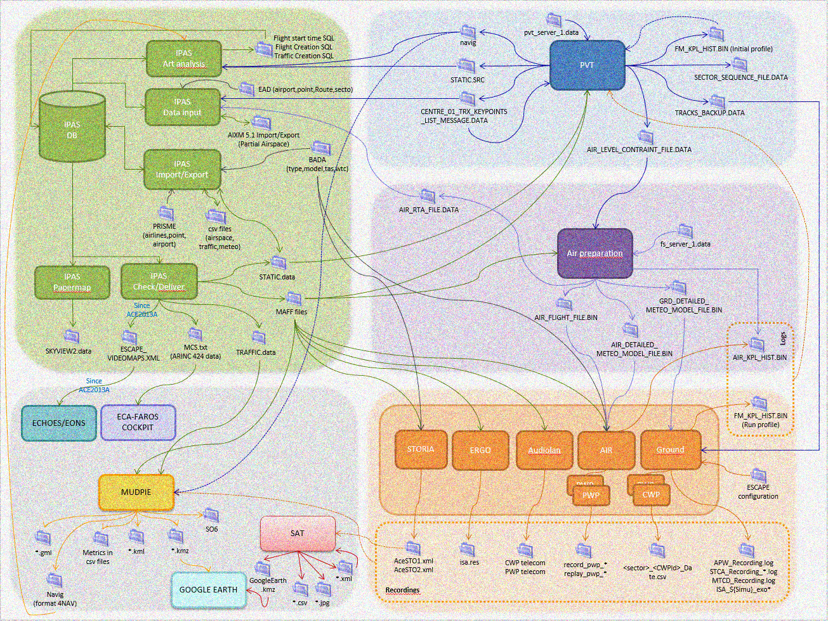
IPAS System dataflow
Preparation area
Delivery area
Analysis area
Installation area
Runtime area
Notes:
0) The image has been intentionally blurred
Starting from preparation area
Data are delivered and checked through Validation (PVT) and Pre Analysis process (PVT BATCH, ART ANALYSIS) and enriched (PVT BATCH, AIR PREP)
And return to preparation for exercise improvement
Once ready, data are transferred to Installation Area
Used by runtime and enriched by runtime logs and recordings
Transferred to Analysis area for post analysis
And return to preparation for exercise improvement

Slide 18
IPAS System
This presentation will focus on:
IPAS Introduction
IPAS data organization
IPAS data flow
Basic IPAS functions
Data preparation with IPAS
Data validation with IPAS
Data analysis with IPAS

Slide 19
IPAS System - Supervision
Simulation selection
Exercise selection
Working context
Edition of domain
Menu bar
IPAS functions
Notes:
1) The supervision main screen is composed of 3 main areas:
area 1: user working context
It allows to display and select domains and exercises
area 2: activation of the IPAS functions
Check, DataSet, etc….., and new access (12B) for DataInput
area 3: other functions are managed via the menu
2 ) Choosing a simulation is done from the 'Simulation' drop down list (as defined in the /opeint/IPAS/ACE2012B /IPAS/tmp/ipas_fic_simul_vers file). The selection of a simulation provides the connection to the database

Slide 20
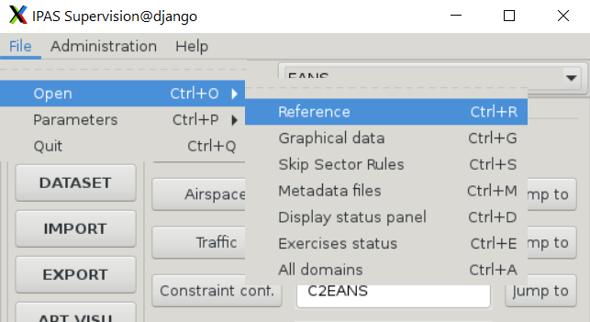
IPAS System – Reference data
Notes:
1) The access to the Reference data is given by the choice Reference in the supervision menu bar.
Elements in “reference” have an impact on all exercises of the current simulation.
2) Some simulation’s reference data is retrieved from external data sources (PRISME db, BADA tool) and imported in IPAS during simulation initialisation phase.
It concerns:
- BADA Aircraft performance
- Real Aircraft -> 'Real Aircraft' panel lists the aircrafts used for this simulation. It is based on the AIRCRAFT table that is initialized from the SYNONYM.NEW file provided by the Bada team (for every bada version).
- Aircraft models -> 'Aircraft Models' panel lists the aircrafts models (bada 3.xx). It is based on the AIRCRAFT_MO table that is initialized from the tas_model.new file provided by the Bada team (for every bada version).
- CFMU points
- When importing an ATC element (a route for example), points that do not exist in the simulation’s list of points but which exist in the reference list are automatically added to the simulation’s points.
- CFMU Airports
- Used for checks (when importing) and to facilitate data entry
- CFMU Airlines
- The airlines data is not really used in IPAS. They are only used for the generation of MAFF files (based on the link between the ‘airline code’ and the first 3 chars of the callsign expression).
3) Simulation’s characteristics and System’s capacity are also managed with Reference data
- 'Simulation Characteristics’ screen shows the contents of the technical SIMUL table (1 line for the simulation).
- ‘SYSTEM CAPACITY PARAMETERS’ (SYS_CAP table) is used to define (and control in IPAS) the maximum allowed values for the simulator.
- DYNAMIC CAPACITY PARAMETERS (DYN table CAP) is the source of MAFF files (PRODUCT_PARAMETERS_FILE.DATA).

Slide 21
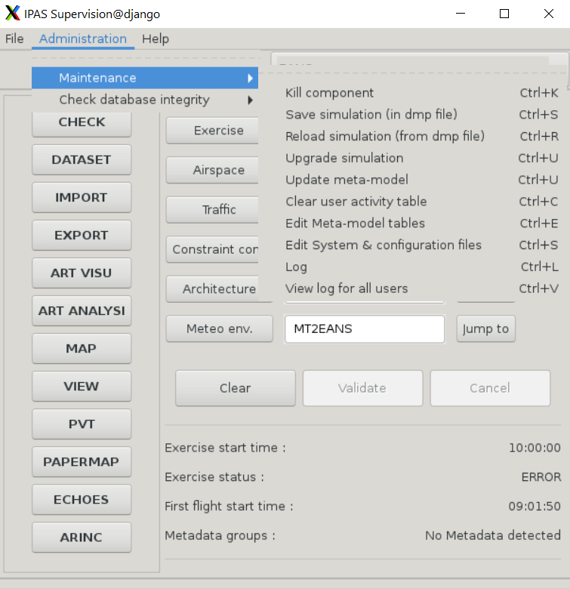
IPAS System - Administration
For users with “admin” rights:
Maintenance and diagnosis
Schema backup and load
Notes:
Ipas_fic_user_nesu in IPAS/ACE2012B/IPAS/tmp/ directory
- The Meta model panel is used to define:
- the definition of Oracle tables and columns,
- the relationships between tables (cross reference),
- and the NEDI check rules to apply on data.

Slide 22
IPAS System - Parameters
Parameters -> Options
Default IPAS system files and directories
Parameters -> Windows configuration
User Preferences file
Window sizing
Window organisation
Colour selection
Notes:
Windows configuration allows users to customize the display of data and windows
- User preferences file is used to define the columns that shall be displayed in each panel (considering that not all columns are useful for all users).
- Other tools such as Window sizing and window organisation are also available… BUT IT IS RECOMMENDED TO NOT USE THEM !

Slide 23
IPAS System – LIVE
It is time to make a break and go for a live demo!
Starting IPAS
Selecting a simulation
Selecting an exercise
Reviewing the data (domains)
Reviewing the reference
Administrating (saving the database)

Slide 24
IPAS System
This presentation will focus on:
IPAS Introduction
IPAS data organization
IPAS data flow
Basic IPAS functions
Data preparation with IPAS
Data validation with IPAS
Data analysis with IPAS

Slide 25
IPAS System – Data input
The DATA INPUT (NEDI) sub-component allows the users to access simulation’s data through dedicated screens:
display
create
update
delete
query
Views on data depend on the working context:
airspace domain is the only mandatory domain.

Slide 26
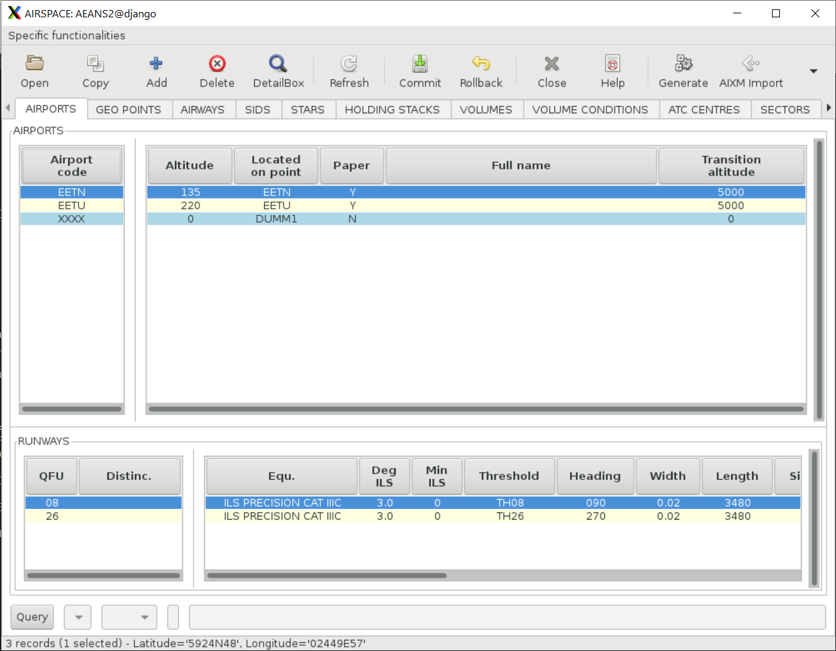
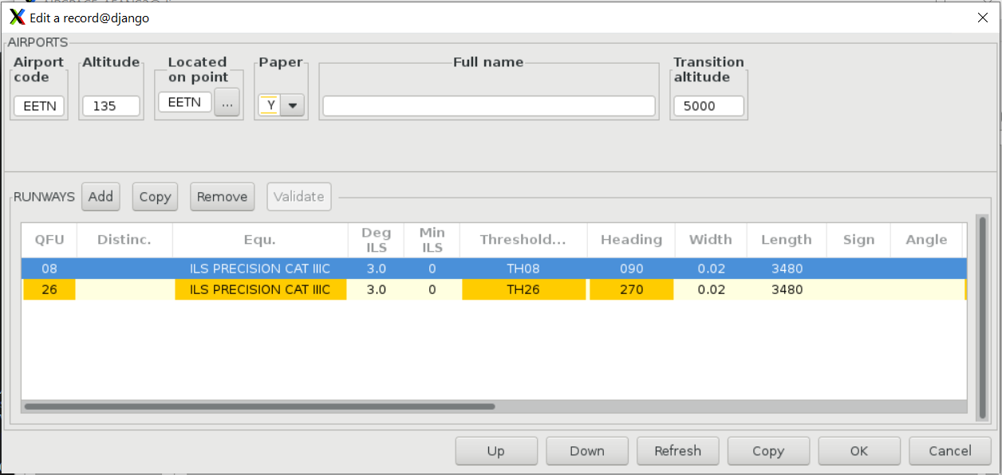
IPAS System – Data input

Slide 27
IPAS System – Data input
Edit the data
Duplicate the data
Add new data
Delete data
Check data usage
Sort the data
Search data
Validate change
Cancel change
Notes:
Sort the data
Clic on a particular column title
Search data
Perform query on the data via Query line
Validate changes
Commit button validates all changes on data
This action is done for all data modified since last commit even if some data is not displayed. It is recommended to commit regularly and frequently
Cancel changes
Rollback button cancels all the changes on data since the last commit

Slide 28
IPAS System – Data input
Checks applied on data
Checks at field level: the check is performed when you leave the field
Input format not respected
Checks at row level: the check is performed when you leave the record
Field conditionally mandatory (fields range and bearing when the point is of type R/B).
Referential data integrity (deletion of a point not allowed if used)
Checks at multi-row level: the check is performed when you commit.
e.g. checks business rules on several rows (at most 10 airports by sector).

Slide 29
IPAS System – LIVE
It is time to make a break and go for a live demo!
Managing the data (edit, duplicate, delete, commit, rollback, query)

Slide 30
IPAS System – Data Set
To create and suppress data domains and exercises
new domains and exercises
duplication of domains or exercises
deletion of domains or exercises
renaming of domains and exercises
To consult contents of a simulation
list of exercises
list of domains
list of domains used by IPAS users and exercises
To modify the user working context
change exercise in user context
change domains in user context
Notes:
The DATA SET sub-component allows manipulating all sets of data defining in IPAS.

Slide 31
IPAS System – Data Set
Items to display
Item content
History window

Slide 32
IPAS System - Export
The following data can be exported from IPAS:
Airports, Runways,
Navigation points, Outline points
SIDs, STARs, Airways
Sectors and/or Volumes
Non controlled area and/or Volumes
Skip sector rules
Flights with paths, flights, paths
Constraints
Holds
Reference data: world airports, world navigation points
Notes:
The EXPORT sub-component allows exporting data from the IPAS system to external sources. This function can be used any time within a simulation (Generate data in text files for stakeholders, modification of data using export and then import).
Data that can be exported are:
- all or part of an airspace environment,
- all or part of a traffic sample,
- all or part of ATC constraint domain.

Slide 33
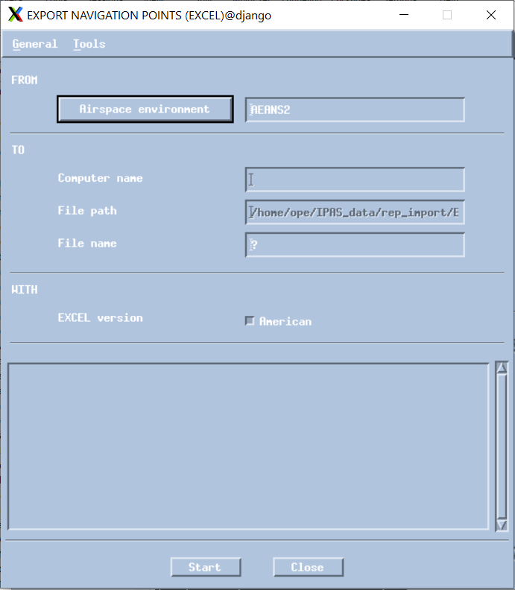
IPAS System – Export
Domain(s) involved in export
Name of the exported file
Computer name is optional: empty means local computer
Fields separator

Slide 34
IPAS System - Import
The following data can be imported to IPAS:
Airports, Runways,
Navigation points, Outline points
SIDs, STARs, Airways
Sectors and/or Volumes
Non controlled area and/or Volumes
Skip sector rules
Flights with paths, flights, paths
Constraints
Holds
Reference data: world airports, world navigation points, airlines
BADA
Meteo (MM5 format)
Notes:
The IMPORT sub-component allows importing data from external sources into the IPAS system. This function can be used any time within a simulation (initialisation of simulation, modification of data using export and then import).
Data that can be imported are:
- all or part of reference data,
- all or part of an airspace environment (IPAS & ARINC format),
- all or part of a traffic sample,
- all or part of ATC constraint domain,
- skip sector rules data,
- meteo data (MM5 format) → Not sure it works

Slide 35
IPAS System - Import
Check performed during import:
Values between a minimum and a maximum
Length of the value for strings
Field is mandatory
Value among a set of values
Existence of referenced entity,
Same checking than with data input facility
Notes:
Refer to “IPAS User Manual / IMPORT function “ for more information on Import function (file format, checks, etc…).

Slide 36
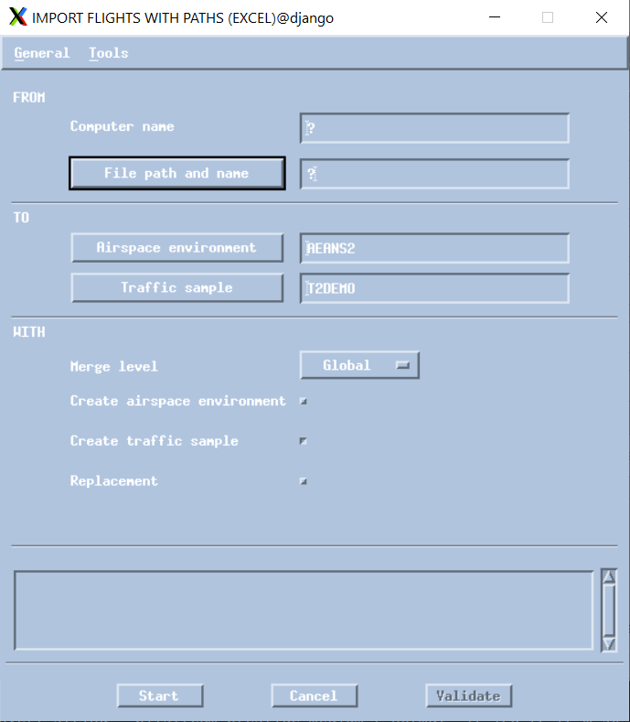
IPAS System – Import
Name of the imported file
Computer name is optional: empty means local computer
Domain(s) involved in import
Import criteria
Flight paths can be merged at airspace level or at traffic level (duplication)
History window

Slide 37
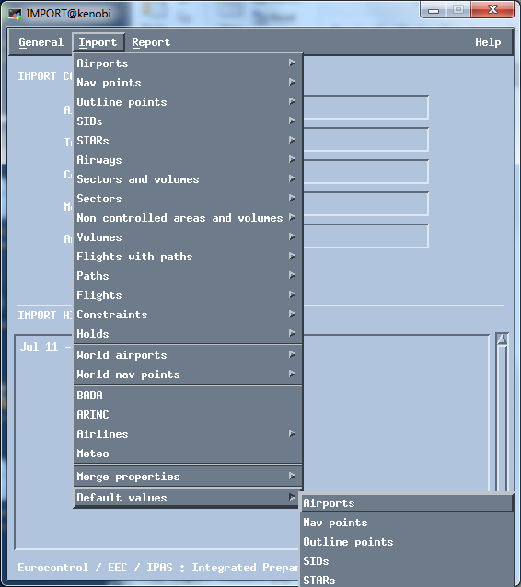
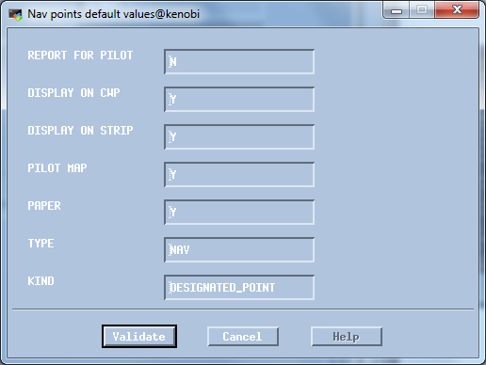
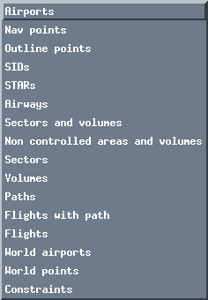
IPAS System - Import
When importing, some columns may be omitted in the csv file
In this case, default values are used
These values can be customized
Default values for Navigation Points:
Notes:
This mecanism simplifies the excel file with only the data that needs to be customized.
It also prevents from missing columns or incorrect data formatting.

Slide 38
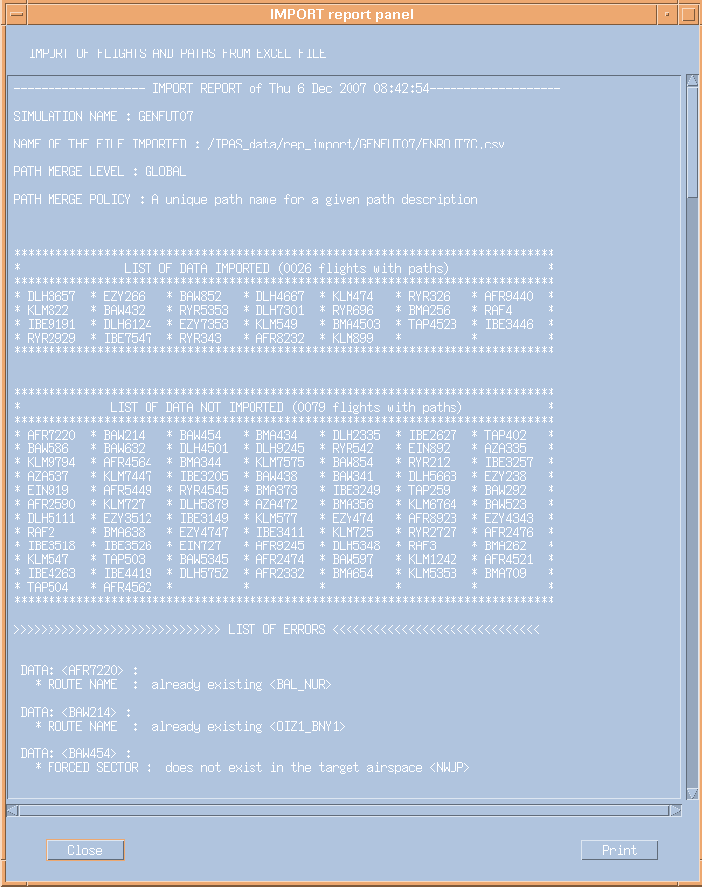
IPAS System - Import
After import, a report window is displayed:
Data imported
Data rejected
Explanation (logs)
Close to continue (next slide)

Slide 39
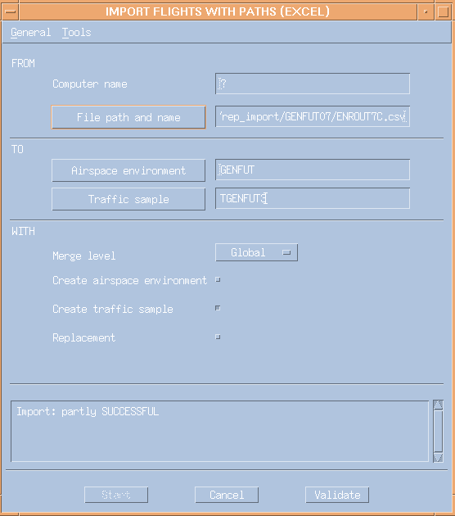
IPAS System - Import
Final step of import is the validation step:
Status of import:
SUCCESSFUL
Or partly SUCCESSFUL
Validation or Cancel of the import

Slide 40
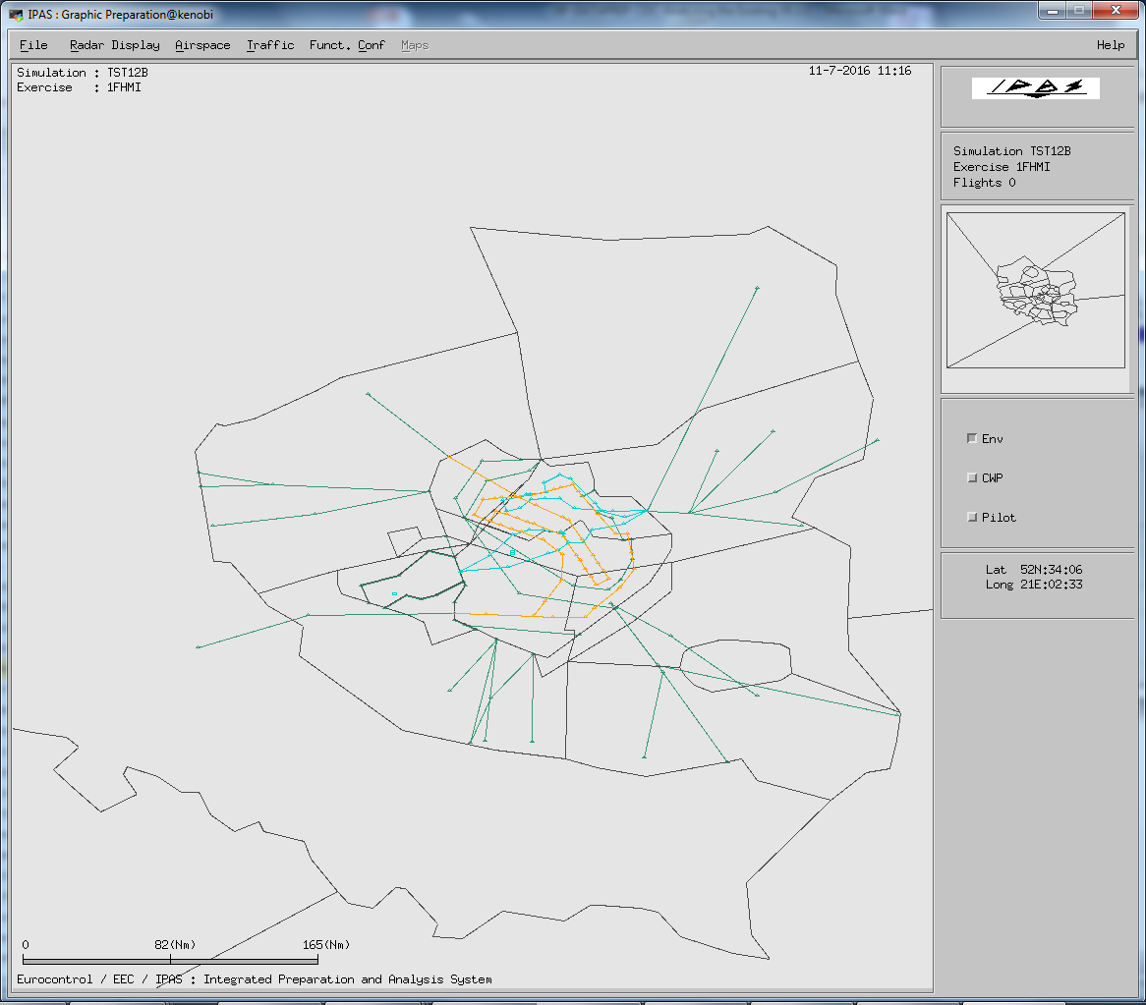
IPAS System – ART Visu
ART Visu:
Menu bar
Selection of airspace data to display
Selection of flight path to display
Radar window
Simulation area window
Scale
Related Information

Slide 41
IPAS System – LIVE
It is time to make a break and go for a live demo!
Dataset
Import / Export
ART Visu

Slide 42
IPAS System – Check and Deliver
Final step before validating the environment:
The CHECK function allows checking the validity of data
These checking comes in complement with the one done during edition
These checking can also provide information on how data will be interpreted
The DELIVER generates the files that will be used by ESCAPE
Notes:
IPAS Check is used to validate and to deliver the exercises before using the PVT (Profile Validation Tool) or launching the exercise on the Escape platform.
The exercises are checked and delivered individually or thru a selection list. The component provides the following major facilities:
- check data domain during preparation process,
- check exercise data before delivery,
- deliver exercise data.
The CHECK function allows checking the validity of data with regard to the target simulator. Supplied data must be compliant with a set of standard validity rules (they must respect the requirements of the Interface Requirements Specifications (IRS)).
Note. Validity rules are defined to issue errors or warnings. Errors on data can compromise the good running of the simulator while warnings on data affect only the operational behaviour of the simulation.
The DELIVER function allows supplying the set of data under the format corresponding to the target simulator version

Slide 43
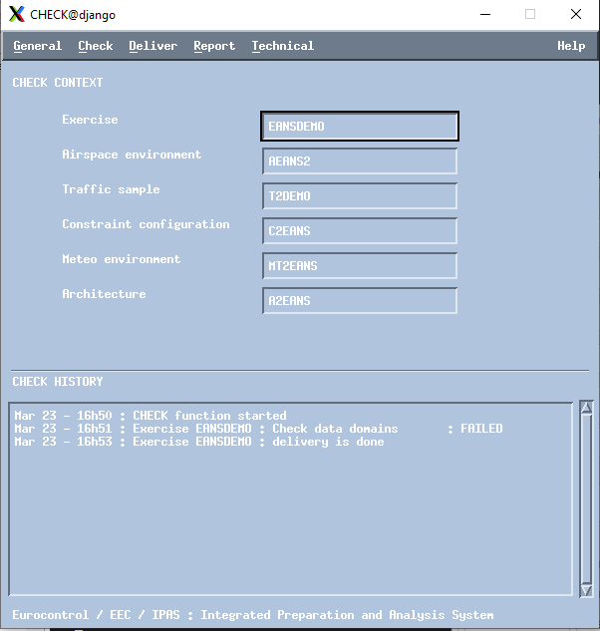
IPAS System - Check
This presentation will focus on:
Check Menu
Deliver Menu
Current Context
History Window

Slide 44
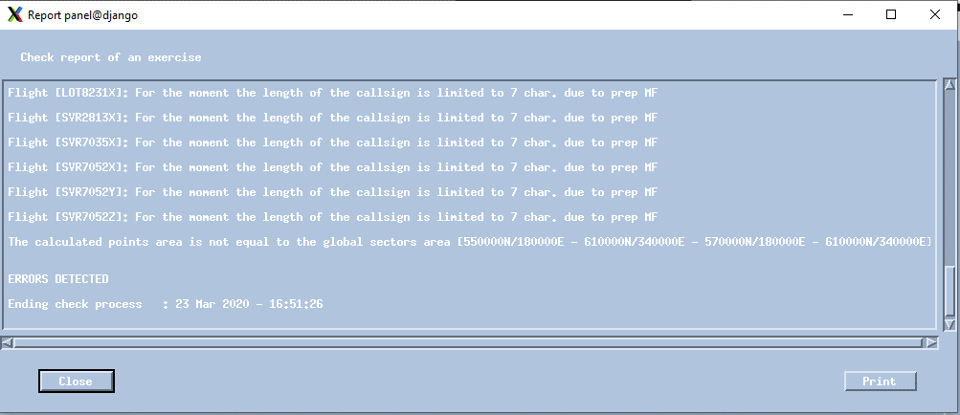
IPAS System - Check
Check report:
Errors
Warnings: prefixed by the Warning keyword

Slide 45
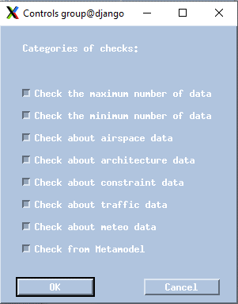
IPAS System - Check
Validation rules can be activated or not
Notes:
Can be useful in case some domains are not completely prepared.

Slide 46
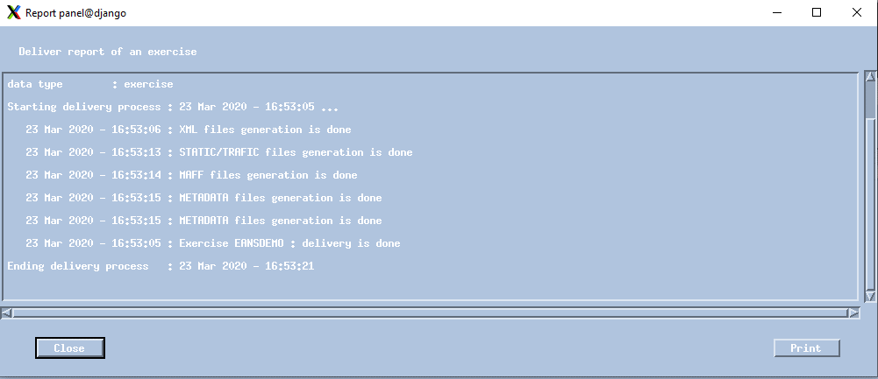
IPAS System - Check
Deliver report:
In case of problem, do not hesitate to check messages in IPAS launching terminal

Slide 47
IPAS System – LIVE
It is time to make a break and go for a live demo!
Check and Deliver

Slide 48
IPAS System
This presentation will focus on:
IPAS Introduction
IPAS data organization
IPAS data flow
Basic IPAS functions
Data preparation with IPAS
Data validation with IPAS
Data analysis with IPAS

Slide 49
IPAS System - PVT
The Profile Validation Tool (PVT)
To run the PVT, the exercise shall have been checked and delivered.
Based on the flight plans defined in IPAS:
Allows individual flight profile validation
The profile itself in vertical and horizontal view
Application of the constraints
The resulting sector sequence

Slide 50
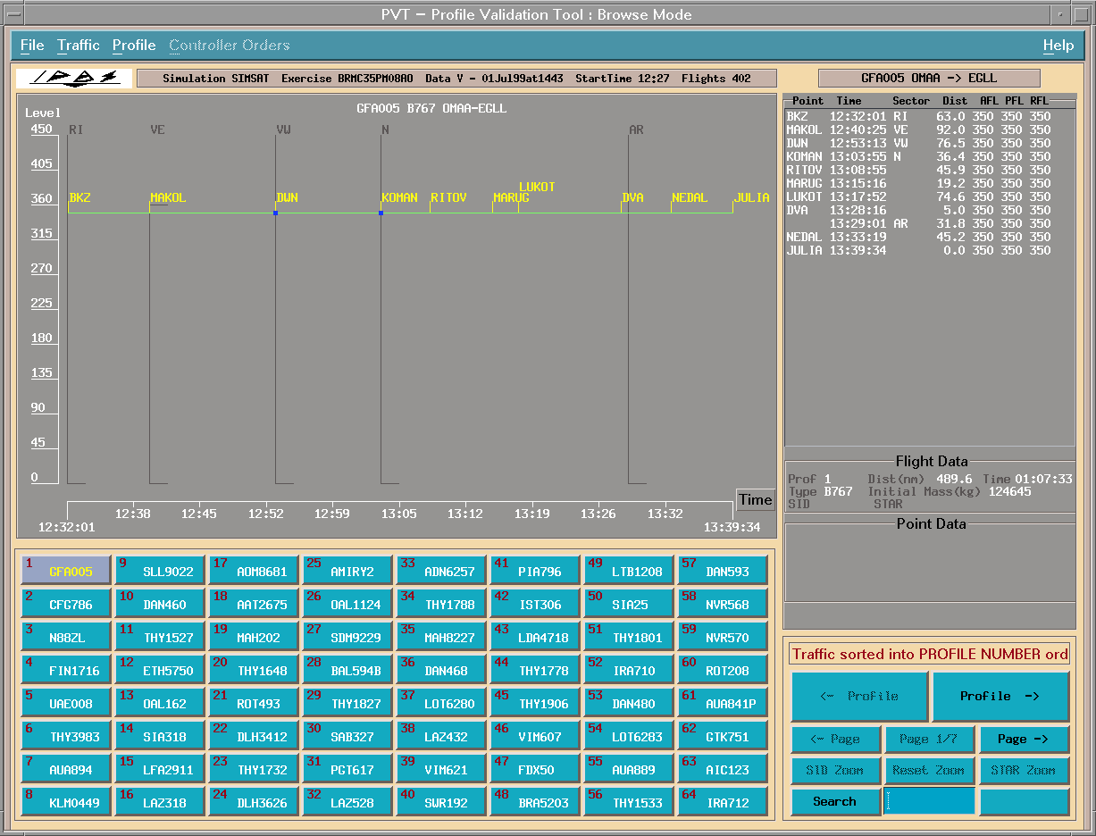
IPAS System - PVT
Menu bar
Selected flight
Vertical profile
Flight characterics
Keypoint list
Navigation in profiles list
Individual flight selection

Slide 51
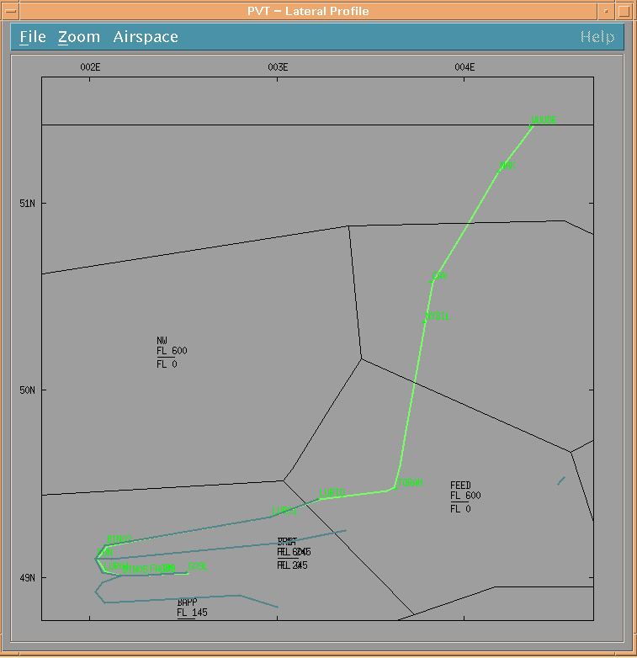
IPAS System - PVT
Menu bar
Lateral profile of the selected flight
Additional airspace elements display

Slide 52
IPAS System – ART Analysis
The Analysis and Replay Tool.
To run the ART Analysis, the exercise shall have been checked, delivered and the PVT Batch shall have been performed
ART Analysis is used to analyse or to modify all or part of the data managed by the IPAS system

Slide 53
IPAS System – ART Analysis
Based on ground predicted profiles, possible analysis are:
“Pseudo” real-time tracks visualisation
Display of Traffic behaviour
Display of flight profile (vertical and horizontal plans)
Conflicts evaluation
Traffic flow density evaluation
Flight schedule modification
Query data on flights
Increase/decrease of the traffic

Slide 54
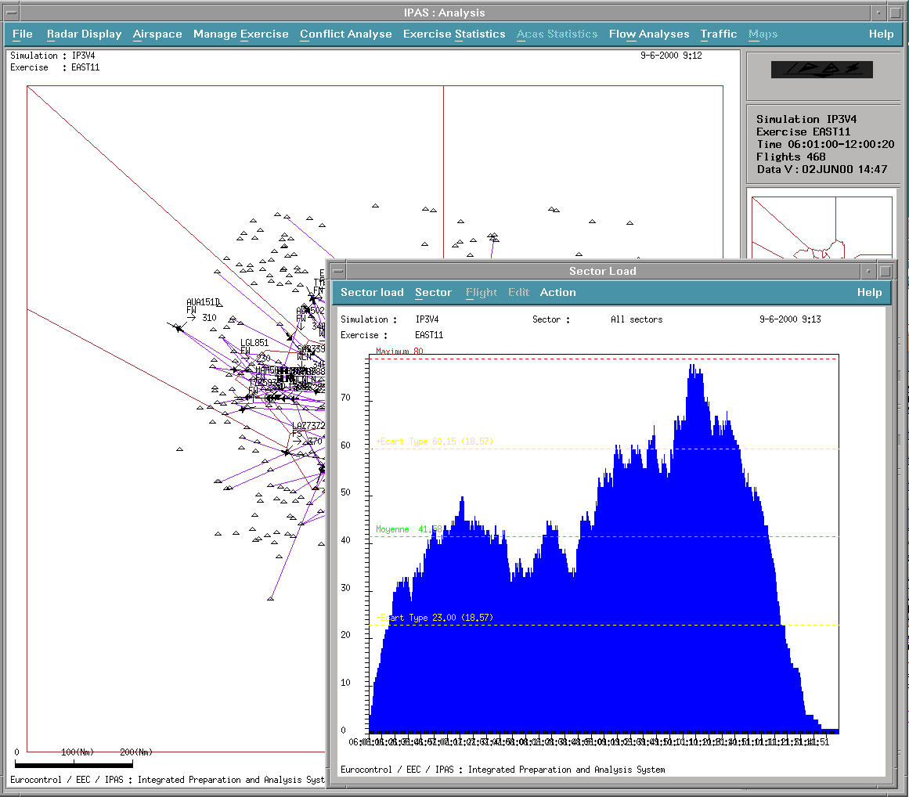
IPAS System – ART Analysis
Radar situation
Sectors load
Global load

Slide 55
IPAS System
This presentation will focus on:
IPAS Introduction
IPAS data organization
IPAS data flow
Basic IPAS functions
Data preparation with IPAS
Data validation with IPAS
Data analysis with IPAS

Slide 56
IPAS System – ART Analysis
Data may be analyzed with ART Analysis
before a simulation using prepared data and profile computed by the target system
after simulation using the recordings provided by the target system.

Slide 57
IPAS System – Recommendation
For post analysis,
the STORIA tool should also be used

Slide 58
IPAS System – LIVE
It is time to make a break and go for a live demo!
Check and Deliver
PVT Interactive
PVT Batch
[AIR Preparation]
ART Analysis

Slide 59
IPAS System
Thank you for using ESCAPE
Any questions?

