Slide 1
ESCAPE Light Training – STC
ESCAPE Supervision Creating and Monitoring a run
Philippe BOUCHAUDON
ATM Simulator Specialist
Created: V1.0 14th of October 2019
Last modified: V1.2 5th of October 2020
Notes:
V1.0 14/10/2019 – Version initiale
V1.1 09/01/2020 – corrections et simplifications des animations
V1.2 05/10/2020 – ESCAPE Light adaptations

Slide 2
ESCAPE Supervision – Part 1
PART 1: Description of the first elements to know to create and start a run
PART 2: Additional explanations on INFRA project and run monitoring

Slide 3
Pre Requisite
ESCAPE is installed and fully operational
On the next slides, it is considered that:
Simulation is: UNISCAPE
ESCAPE user is: uniscape
Simulation main server is: empgrd01

Slide 4
Starting ESCAPE Supervision
Starting using an alias (if created)
Starting not using an alias (user query)
Starting with user
[runesc@empgrd01 ~]$ l
[runesc@empgrd01 ~]$ /exercises/prepesc/escape/runesc2019A/bin/launch_spv
Enter Escape Supervision Login please:
uniscape
/exercises/prepesc/escape/runesc2019A/bin/launch_spv -u uniscape

Slide 5
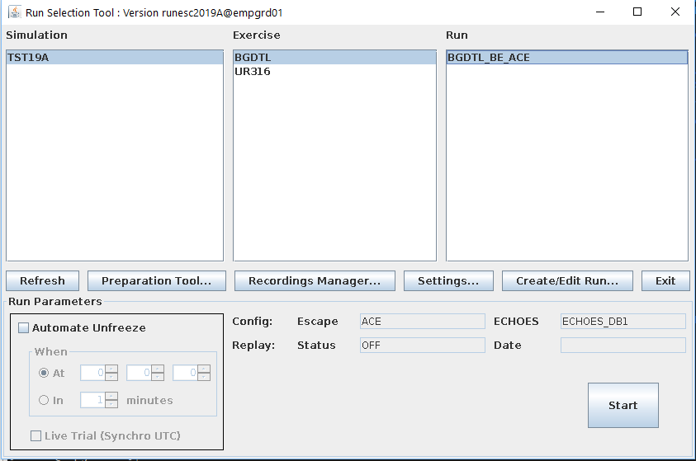
ESCAPE Supervision main screen
Notes:
List of available simulations
List of available exercises (in the selected simulation)
List of the available runs (for the selected exercise)
Run global settings
Run creation / Edition tool
Run related information
Start button
Or Exit button

Slide 6
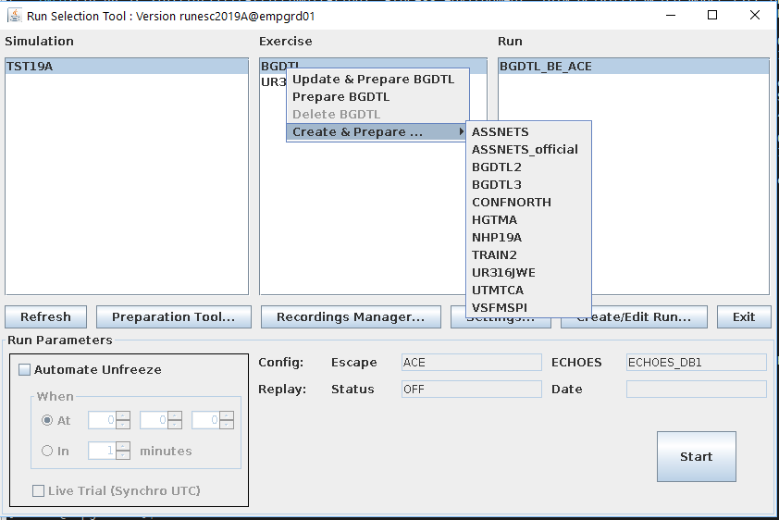
ESCAPE Supervision adding new exercise

Slide 7
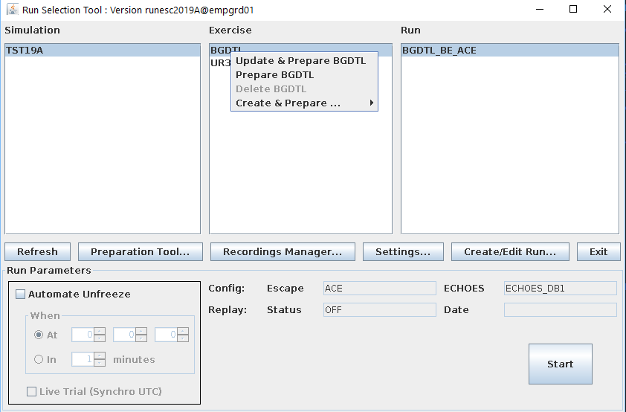
ESCAPE Supervision updating exercise

Slide 8
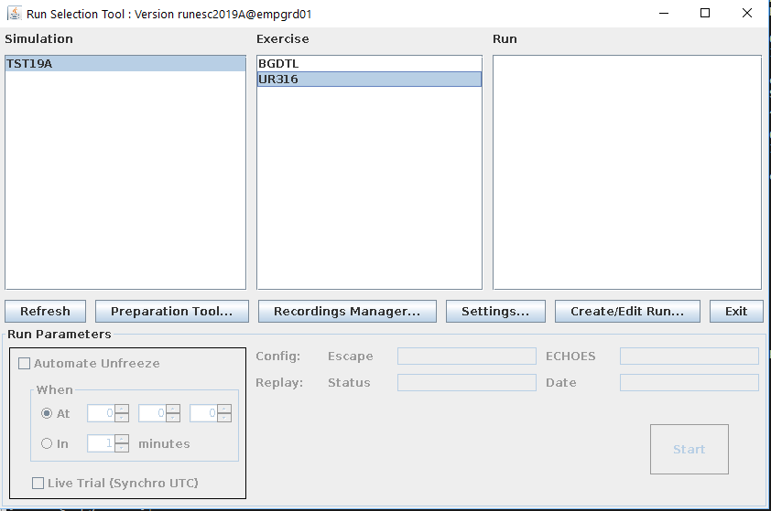
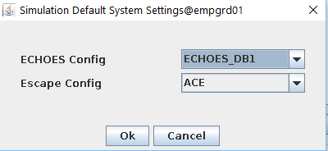
ESCAPE Supervision creating a run (1)

Slide 9
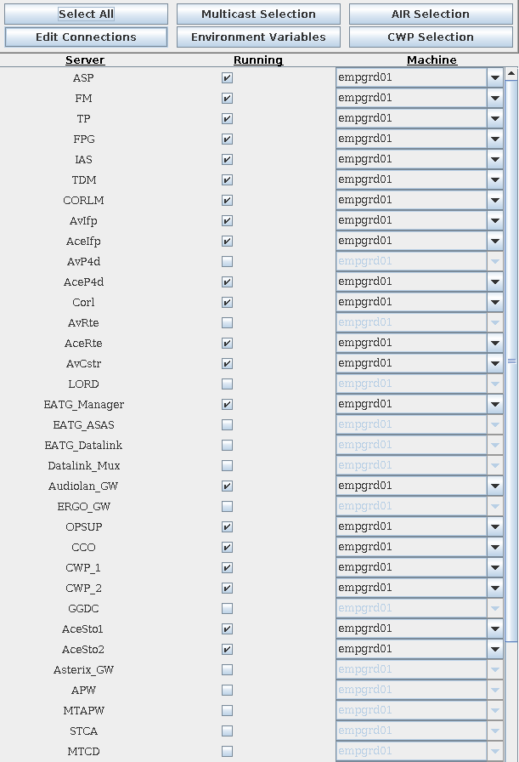
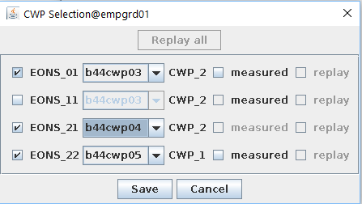
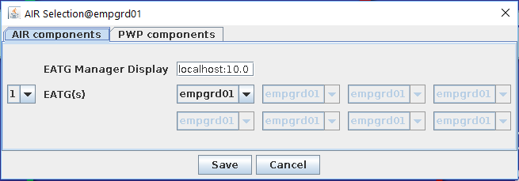
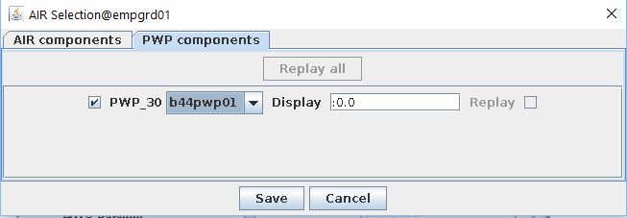
ESCAPE Supervision creating a run (2)

Slide 10
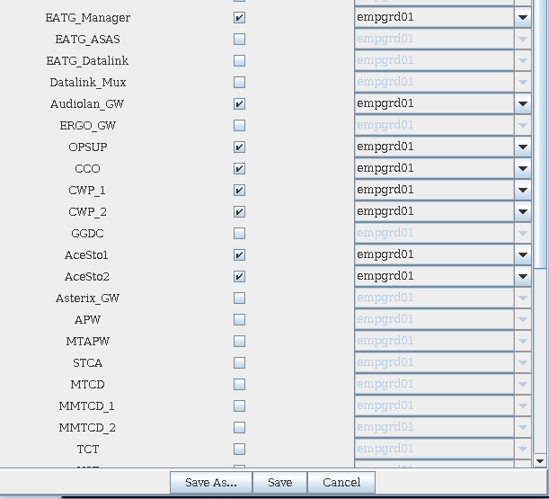
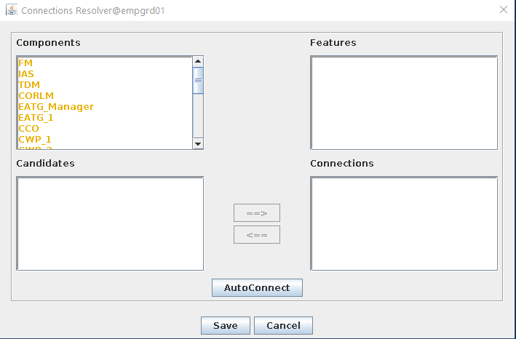
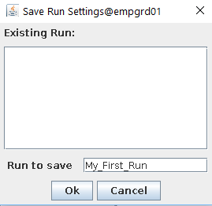
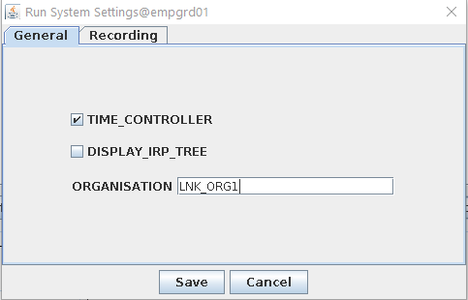
ESCAPE Supervision creating a run (3)

Slide 11
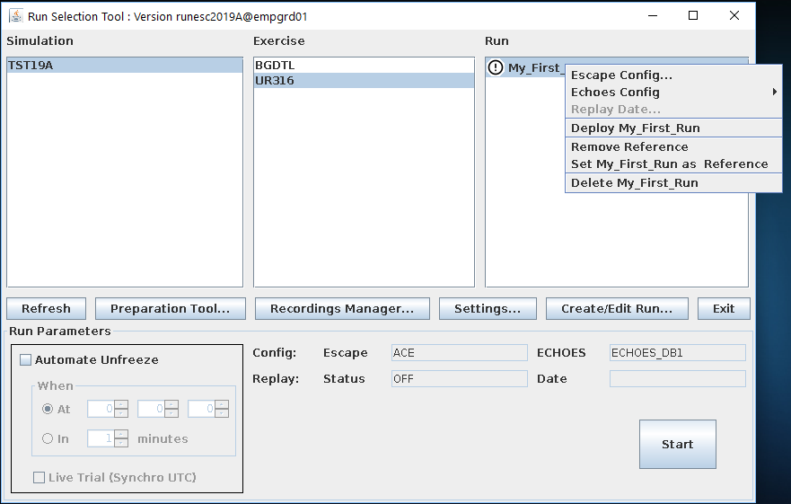
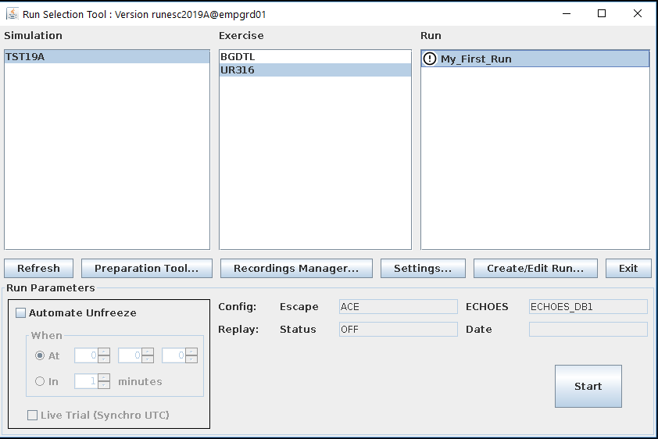
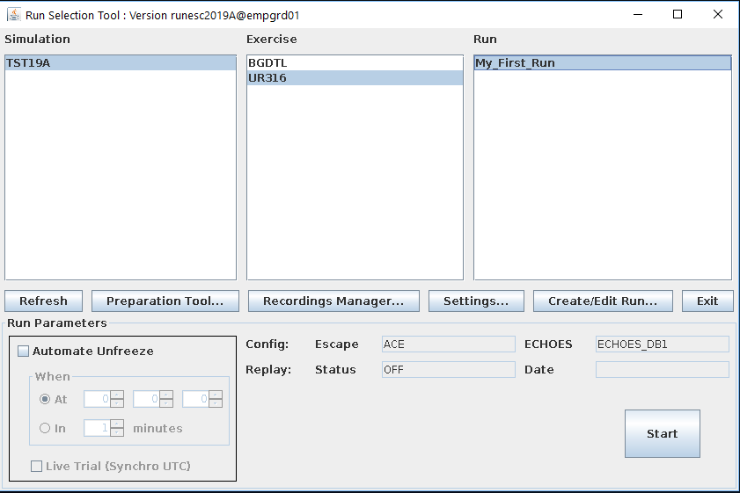
ESCAPE Supervision deploying run

Slide 12
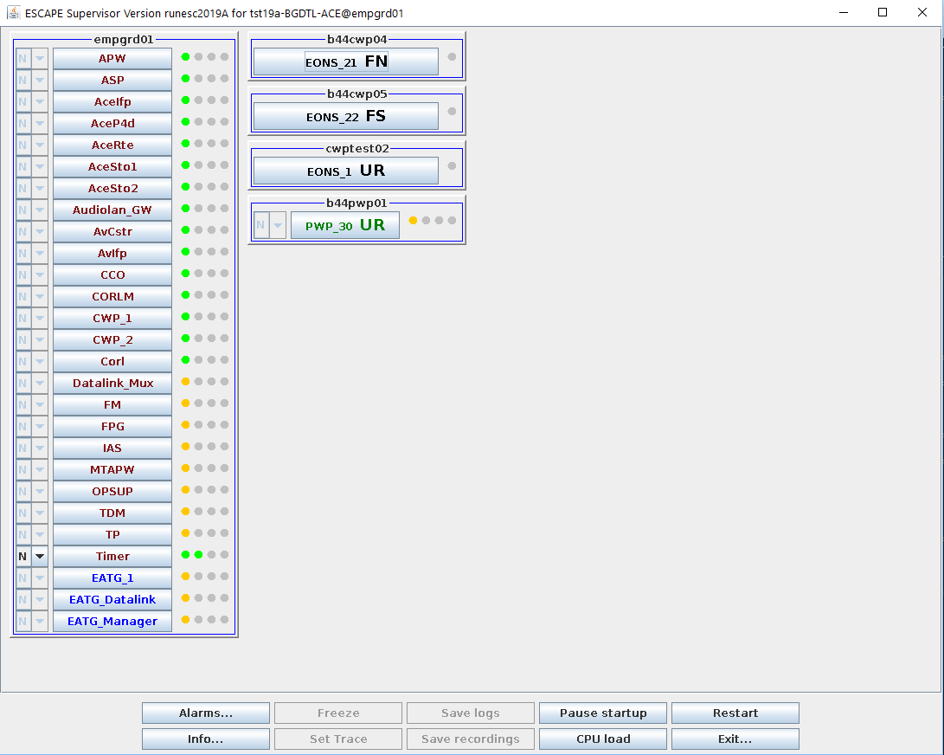
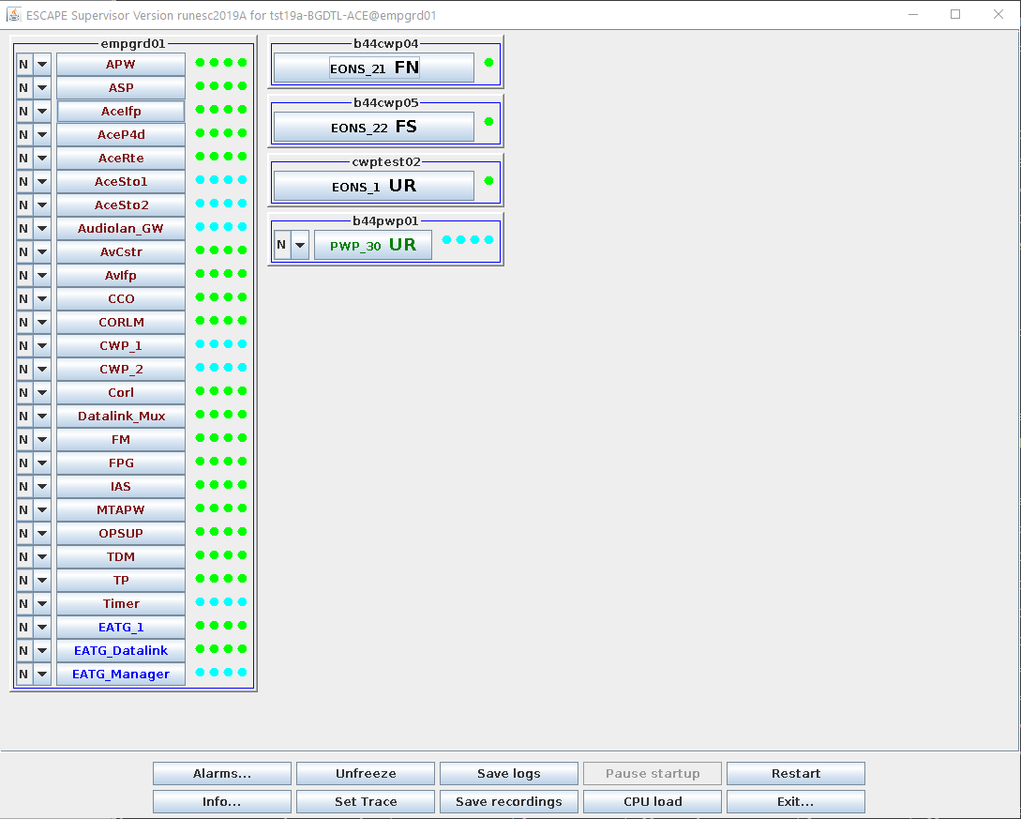
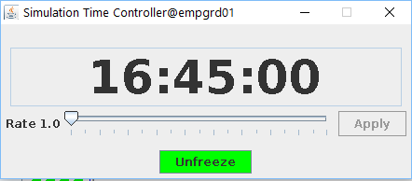
ESCAPE Supervision starting run

Slide 13
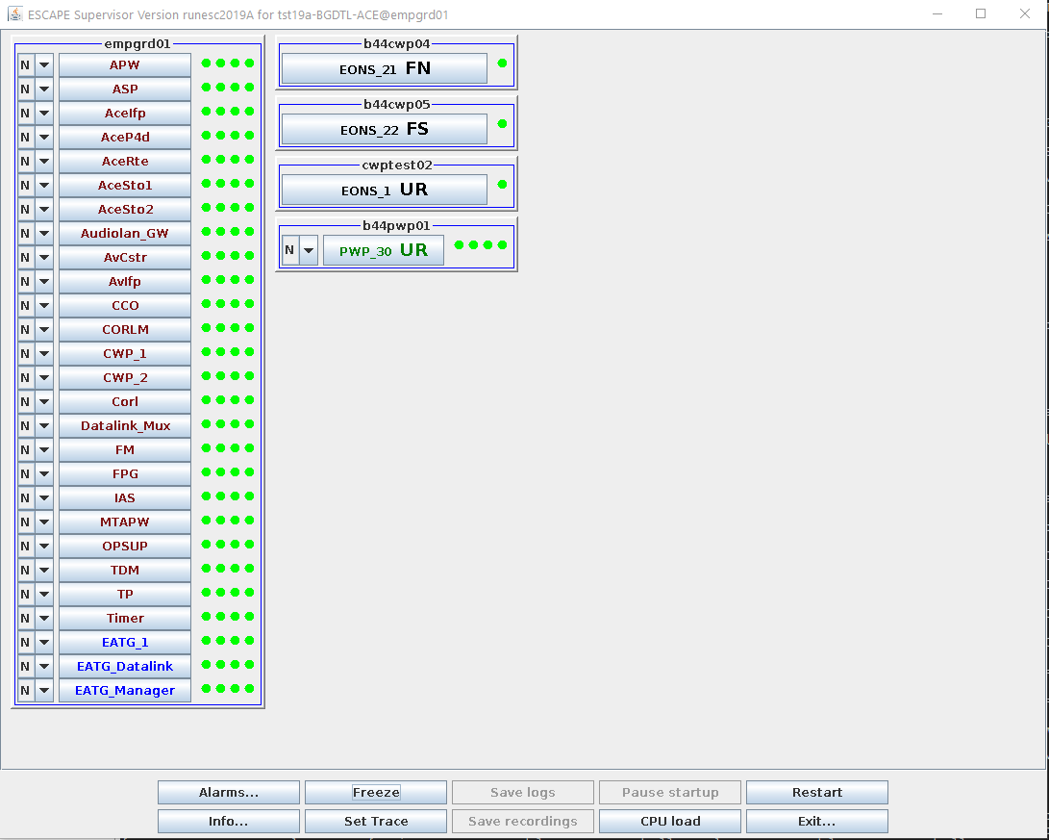
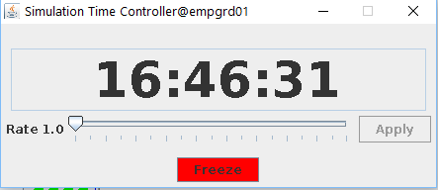
ESCAPE Supervision running

Slide 14
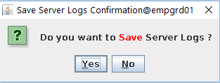
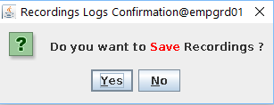
ESCAPE Supervision stopping run

Slide 15
ESCAPE Supervision – Part 2
PART 1: Description of the first elements to know to create and start a run
PART 2: Additional explanations on INFRA project and run monitoring

Slide 16
ESCAPE INFRA Project
ESCAPE INFRA Project is composed of:
The installation tool (run_escape)
The ESCAPE supervision
The ESCAPE middleware (OASIS)
The Timer Component

Slide 17
ESCAPE OASIS Project
OASIS is:
a soft, real-time, framework aimed at simulation activities.
used by the EEC ATC real-time simulator ESCAPE.
This framework offers an object-oriented distribution based on CORBA implementations (TAO, JavaIDL & ORBexpress) as well as advanced object services.
OASIS aims at providing simulator component developers with a simple standard based framework and a high level abstraction of network distribution.
OASIS also offers integrators and deployers with advanced recording and diagnostic tools.

Slide 18
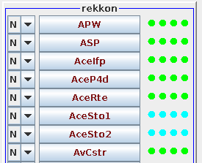
ESCAPE Components monitoring
Supervision provides the following indications:
The server running the component
The state running / frozen of the component
Successive starting states
Created
Initialized
Connected
Synchronized
Alarms and reports

Slide 19
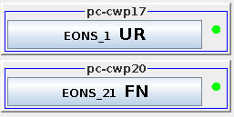
ESCAPE Components monitoring
Components fully monitored
Components “partly” monitored
Controller position are partly monitored
These components are launched and monitored by CWP component which report the state to the supervision

Slide 20
ESCAPE Supervision
Thank you for using ESCAPE
Any questions?

Slide 21
ESCAPE Supervision – Exercise 1
Exercise 1 – Creation of a run
Steps (part 1):
Connection on main server
Start of Supervision
Check of the available simulation and exercise
For Simulation SSS Exercise XXX create a new run:
Ground components running on ground server
Air components running on ground server
PWP allocated:
1 ->
CWP allocated:
1 ->
Software Config CCC, ORG GGG, ECHOES_DB BBB

Slide 22
ESCAPE Supervision – Exercise 1
Exercise 1 – Creation of a run
Steps (part 2):
Run deployment
Run start
Run unfreeze
Time monitoring
Run freeze
Run stop
Logs saving
Recordings saving

Slide 23
ESCAPE Supervision – Exercise 2
Exercise 2 – Change run layout: swap PWP and CWP
Steps (part 1):
Change of CWP machine allocation
Change of PWP machine allocation
Check of results in runtime

Slide 24
ESCAPE Supervision – Exercise 3
Exercise 3 – Change of Software Configuration (alternate one shall be available – change of radar rate to 1 second for instance)
Steps (part 1):
Change of Software configuration
Check of results in runtime

Slide 25
ESCAPE Supervision – Exercise 4
Exercise 4 – Execution of a PWP replay (a replay shall be available)
(a PWP configuration displaying replay shall be available)
Steps (part 1):
Sets of the PWP in replay mode
Selection of the replay date
Change of the PWP configuration file in replay mode (or selection of an ad’hoc config)
Check of results in runtime

