Slide 1
ESCAPE Training – STC and IPAS
ESCAPE Overview
Philippe BOUCHAUDON
ATM Simulator Specialist
Created: 12th of September 2019
Last update: V1.1 21st of January 2020

Slide 2
ESCAPE Overview - Summary
This presentation is an overview of ESCAPE
Usage / Main features
Capacities
It includes a top level description of the main components
Feature
Architecture

Slide 3
ESCAPE Overview
The ESCAPE simulator is the:
Air Traffic Control
Real Time Simulation system
provided by EUROCONTROL.
The ESCAPE simulator emulates:
  a full control room with working positions for the controllers,
  a sophisticated ground system,
  a real time air navigation,
  several off-line tools.
With high flexibility to provide to each client a dedicated up-to-date ATM simulation environment

Slide 4
ESCAPE Capacities
ESCAPE simulator an handle up to:
1000 active aircrafts
2000 flights plans
64 controller working positions
70 pilot positions

Slide 5
ESCAPE Overview - Summary
This presentation is an overview of ESCAPE
Usage / Main features
Capacities
It includes a top level description of the main components:
Ground CORE system
Controller Working Position and ECHOES
AIR System
INFRA System
Datalink System
Ground Tools - Safety
Ground Tools - Extensions / Gateways
STORIA System - Recording and Analysis
IPAS System
…

Slide 6
GROUND CORE System
The GROUND CORE system is set of components allowing:
flight plans management
radar tracks processing
flights monitoring
supplying interface with external systems

Slide 7
GROUND CORE System
OASIS
AIR System
GROUND
System
RDPS
FDPS
Correlation
Airspace
IPAS Files
Monitoring
Datasets
CWP System / Tools / Safety / Gateways …

Slide 8
ESCAPE Overview - Summary
This presentation is an overview of ESCAPE
Usage / Main features
Capacities
It includes a top level description of the main components:
Ground CORE system
Controller Working Position and ECHOES
AIR System
INFRA System
Datalink System
Ground Tools - Safety
Ground Tools - Extensions / Gateways
STORIA System - Recording and Analysis
IPAS System
…

Slide 9
Controller Working Position System
The Controller Working Position (CWP) system is set of components allowing
connection with ESCAPE system through OASIS middleware
based on industry standard ATC HMI builder, ODS toolbox
  Transformation of ESCAPE data to Conceptual Object
  Presentation of Conceptual Object as Presentation Object
ECHOES HMI
EUROCONTROL Consolidation of HMI for Operations, Experimentations and Simulations
Highly configurable and flexible HMI software, reducing development cost and risk through harmonisation and re-use

Slide 10
Controller Working Position System
Based on Operational Specifications, ECHOES implements:
Monitoring Aids
Safety Nets
Data exchange and Co-ordination (ground ground communication)
Datalink air-Ground data Communication
Automatic Dependent Surveillance
Medium Term Tools
Trajectory Edition
ECHOES also implements:
Arrival Management (with external system)
Airborne Separation Assurance System
Required Arrival Time
Time Based Separation
Tactical Controller Tools
…

Slide 11
Controller Working Position System
OASIS
AIR System
GROUND System
CWP System
OPSUP
IPAS Files
CWP
CWP
EONS
EONS
EONS
EONS
ECHOES
ECHOES
ECHOES
ECHOES

Slide 12
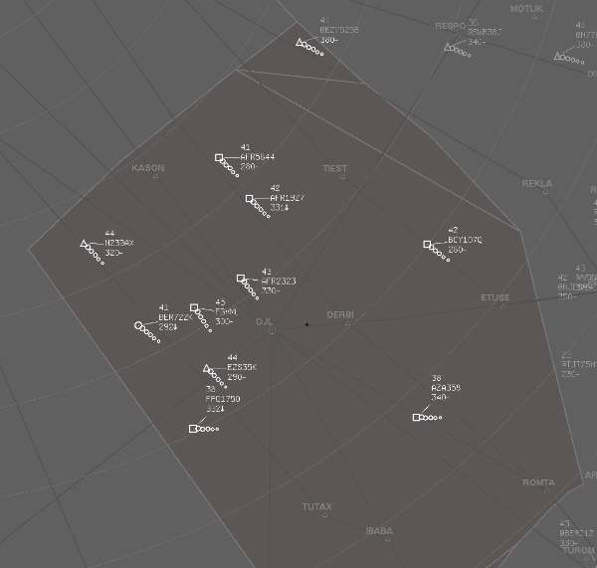
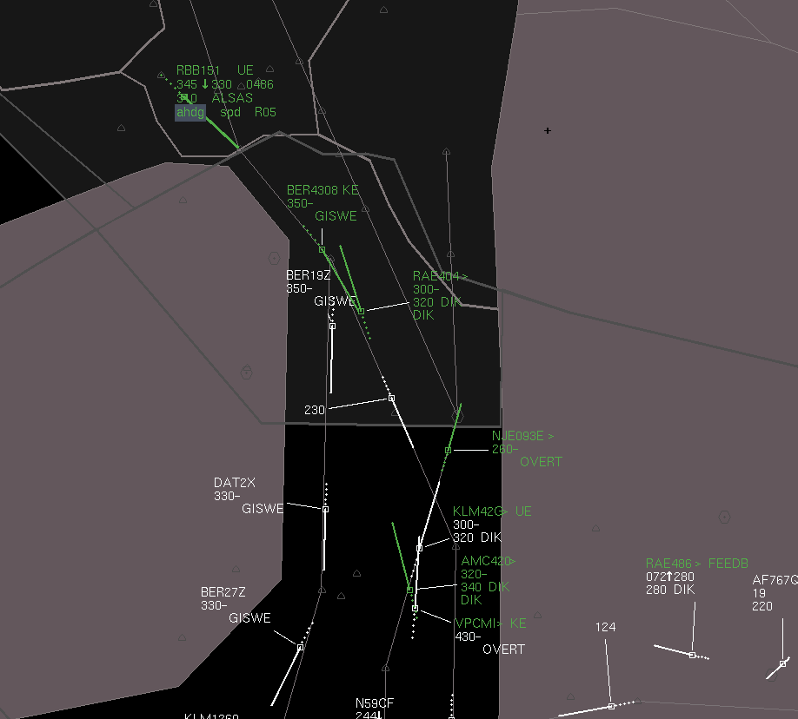
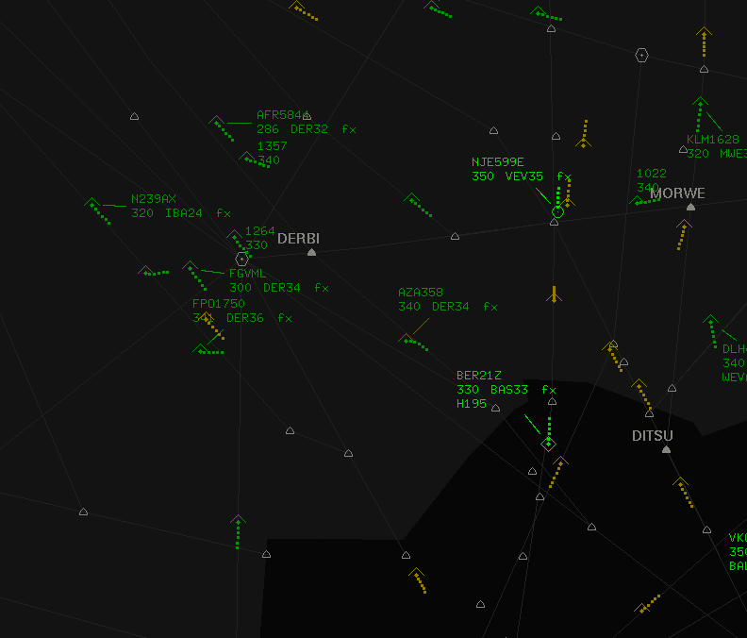
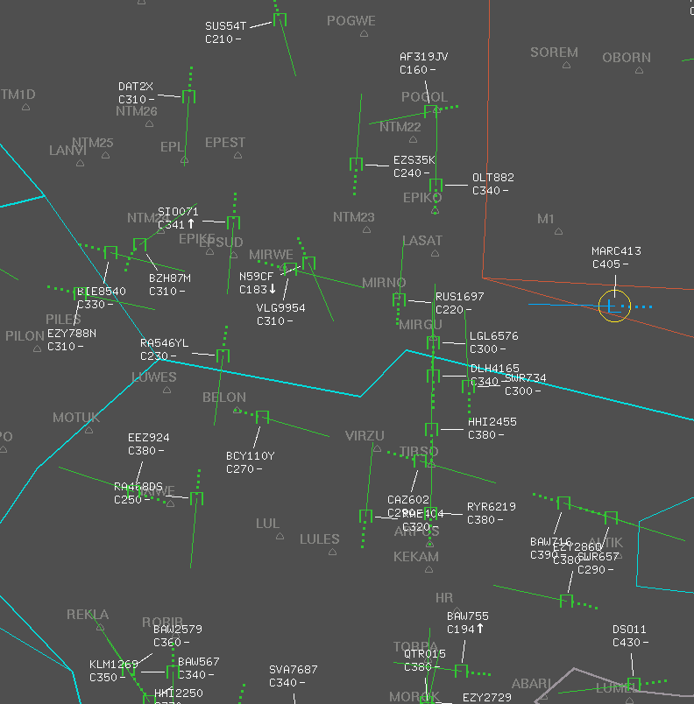
Controller Working Position System - ECHOES
Customizations

Slide 13
ESCAPE Overview - Summary
This presentation is an overview of ESCAPE
Usage / Main features
Capacities
It includes a top level description of the main components:
Ground CORE system
Controller Working Position and ECHOES
AIR System
INFRA System
Datalink System
Ground Tools - Safety
Ground Tools - Extensions / Gateways
STORIA System - Recording and Analysis
IPAS System
…

Slide 14
AIR System
The ESCAPE AIR system is made up of:
  The Enhanced Air Traffic Generator (eATG) – composed of flights sets (FS)
  Pilot Position human interfaces allowing to handle the simulated aircraft (PWP)
  A supervision ensuring load balancing over pilots and flights sets (EM)
  Datalink communication facility
  ASAS facility

Slide 15
AIR System
OASIS
AIR System
EATG Manager
PWP
Flight Set
PWP
Flight Set
PWP
Flight Set
IPAS Files
PWP
Flight Set
Datalink
ASAS
GROUND System
CWP System

Slide 16
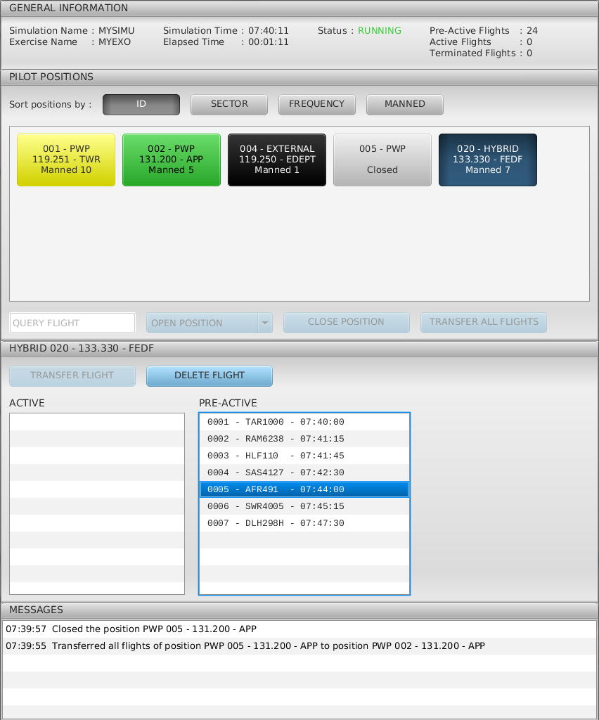
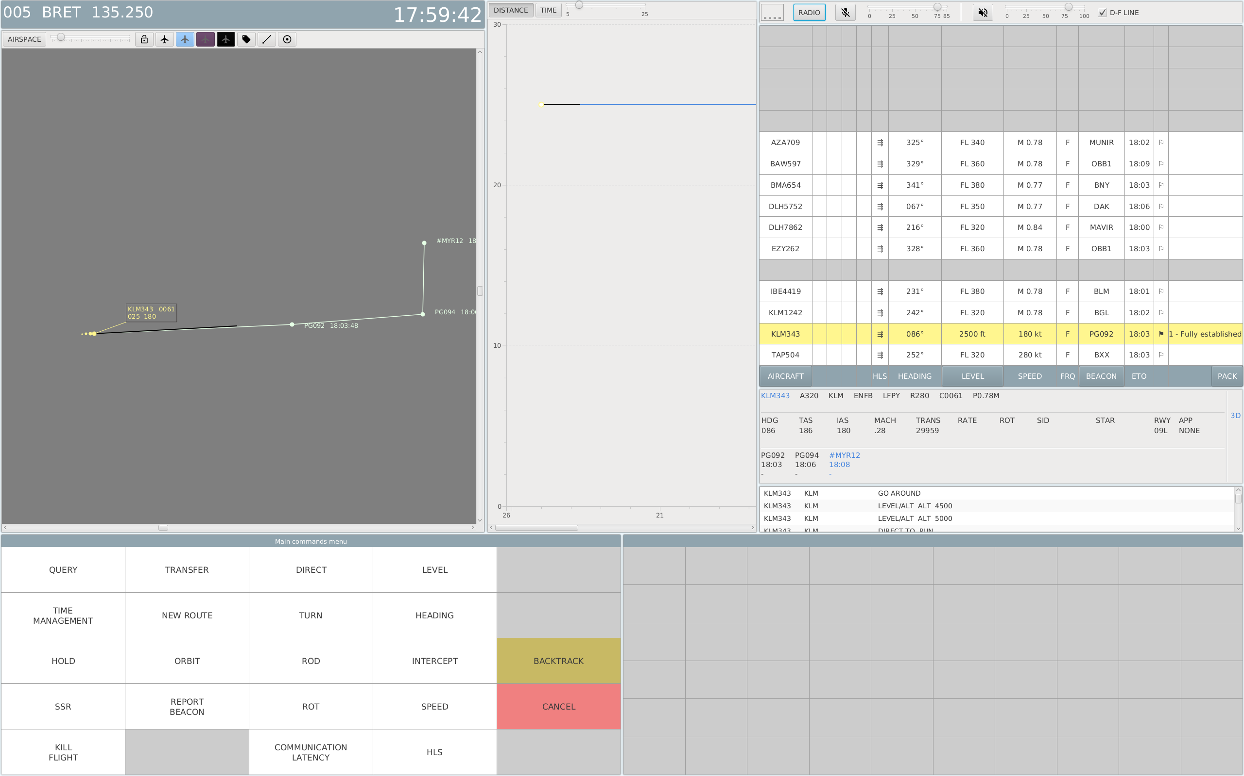
AIR System

Slide 17
ESCAPE Overview - Summary
This presentation is an overview of ESCAPE
Usage / Main features
Capacities
It includes a top level description of the main components:
Ground CORE system
Controller Working Position and ECHOES
AIR System
INFRA System
Datalink System
Ground Tools - Safety
Ground Tools - Extensions / Gateways
STORIA System - Recording and Analysis
IPAS System
…

Slide 18
INFRA System
INFRA System is composed of the following elements:
  OASIS System: middleware facilities over CORBA technology
    Ensure all runtime data communication between ESCAPE components
    Ensure logging and monitoring facilities
  ESCAPE Supervision
    Ensure the run creation, components selections and connections
    Linking exercise, Software Configurations, replays together
    Defining the physical deployment of components on platform hosts
    Monitoring the run lifecycle (start, stop, unfreeze, freeze)
    Ensuring logs and recordings saving
    …
  ESCAPE Installation: “run_escape” tool
    Ensure the ESCAPE installation and binaries deployment over a platform
    Creation of Simulations (runtime side)
    Installation of exercises
    Creation of “ESCAPE users”
    Defining default ESCAPE configurations

Slide 19
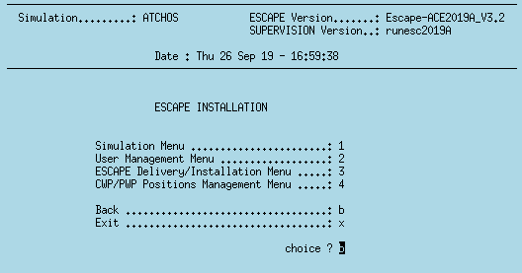
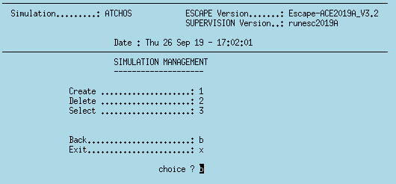
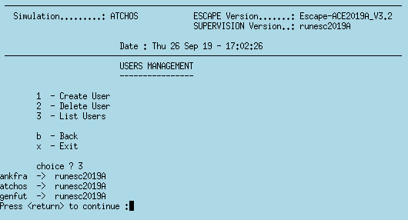
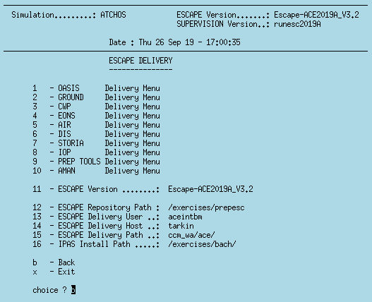
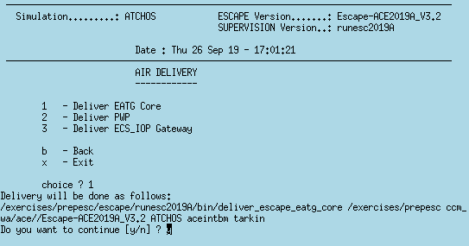
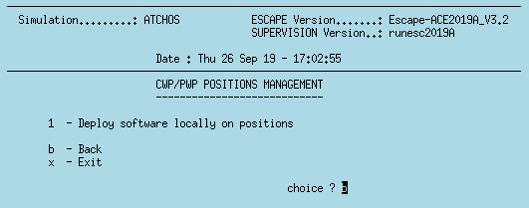
INFRA System – ESCAPE installation

Slide 20
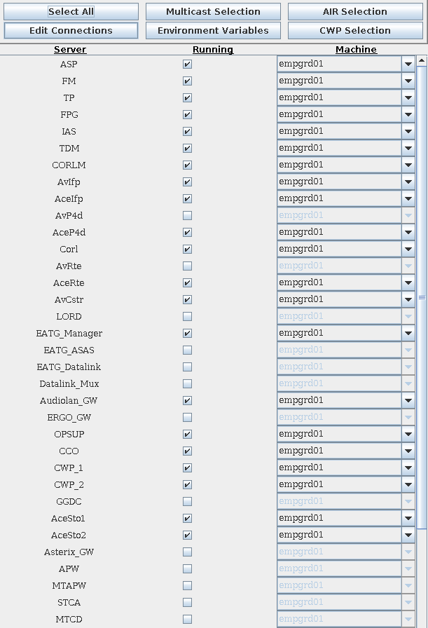
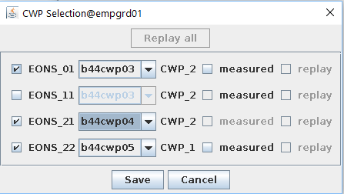
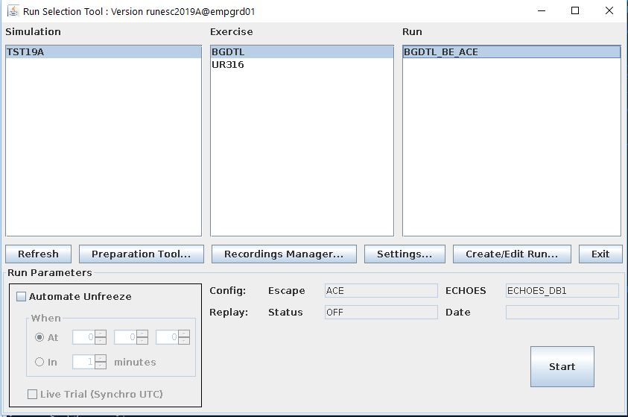
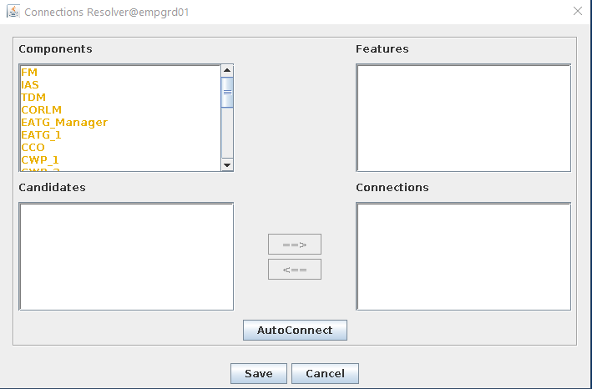
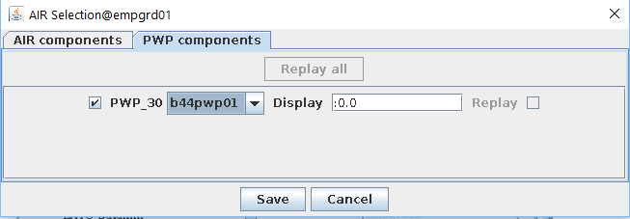
INFRA System – ESCAPE Supervision

Slide 21
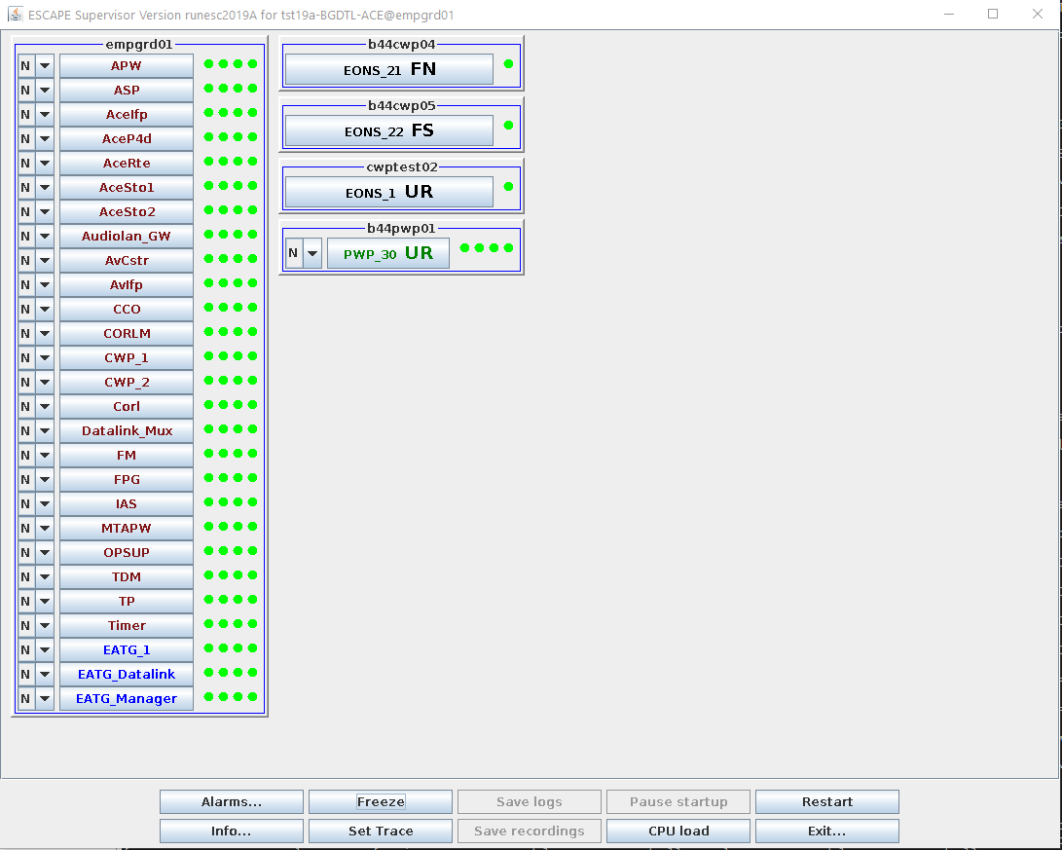
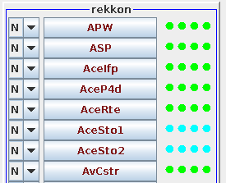
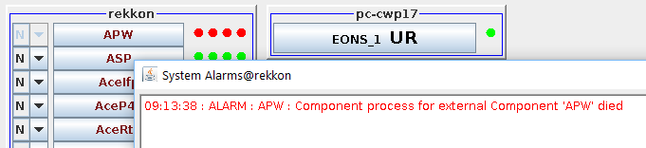
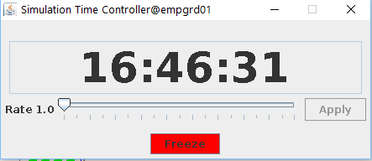
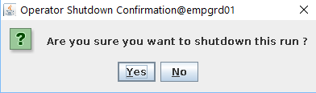
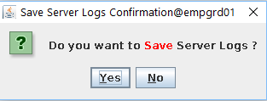
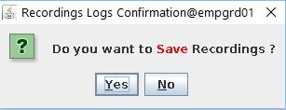
INFRA System – ESCAPE OASIS Monitoring

Slide 22
ESCAPE Overview - Summary
This presentation is an overview of ESCAPE
Usage / Main features
Capacities
It includes a top level description of the main components:
Ground CORE system
Controller Working Position and ECHOES
AIR System
INFRA System
Datalink System
Ground Tools - Safety
Ground Tools - Extensions / Gateways
STORIA System - Recording and Analysis
IPAS System
…

Slide 23
DATALINK System
The Datalink system is a link between the Controller system and the Piloting System. It reflects real system allowing silent communication between Controllers and Pilots (with no use of Radio)
Main functionalities:
Connection establishment
Transfer management
Clearance and Proposal, Uplink and Downlink
Surveillance
This function is based on three Datalink applications:
Context Management (CM) allowing DataLink Initiation Capabilities (DLIC) services,
Controller Pilot DataLink Communications (CPDLC) allowing both ATC Communications Management (ACM) and ATC Clearance (ACL) services
Pilot Preferences Downlink (PPD).

Slide 24
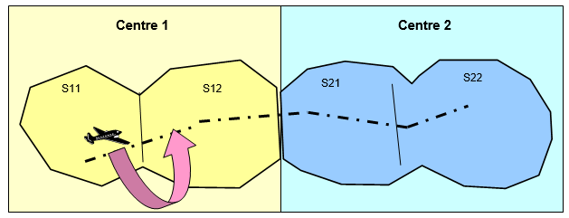
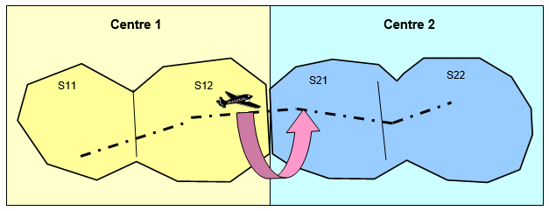
DATALINK System - Transfers
Intra center transfer
Extra center transfer

Slide 25
DATALINK System - Principle
Air System
OASIS
Datalink
System
CM Chain
CPDLC Chain
ADS Chain
DLIC AIR
ACL AIR
ACM AIR
CPDLC AIR
ATN LITE
ADS
CPDLC GRD
DLIC GRD
ACL GRD
ACM GRD
CPDLC MUX
Controller System

Slide 26
ESCAPE Overview - Summary
This presentation is an overview of ESCAPE
Usage / Main features
Capacities
It includes a top level description of the main components:
Ground CORE system
Controller Working Position and ECHOES
AIR System
INFRA System
Datalink System
Ground Tools - Safety
Ground Tools - Extensions / Gateways
STORIA System - Recording and Analysis
IPAS System
…

Slide 27
GROUND Tools - Safety
Detection area
Flight 1 + lookahead
Conflict Area
STCA
MTCD
Minimum separation
For each eligible
pair of flights
Flight 2 + lookahead
Detection area
Horizontal separation
Vertical separation

Slide 28
GROUND Tools - Safety
APW
MTAPW
Flight 1 + lookahead
Reserved Area
For each flights
Flight 1 P4D + lookahead
Reserved Area
For each flights

Slide 29
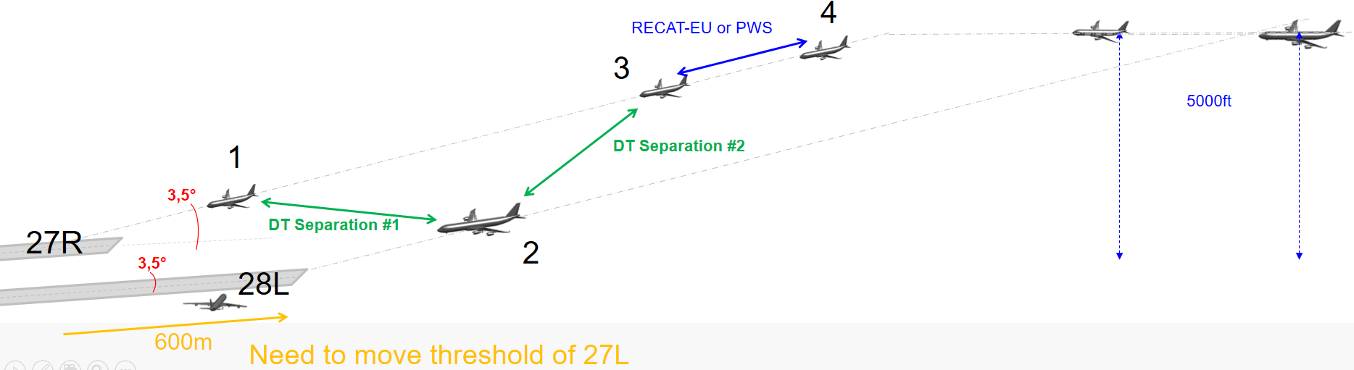
GROUND Tools - Safety
TCT
LORD
Detection area
Flight 1 P4D + lookahead
Flight 2 position + lookahead

Slide 30
ESCAPE Overview - Summary
This presentation is an overview of ESCAPE
Usage / Main features
Capacities
It includes a top level description of the main components:
Ground CORE system
Controller Working Position and ECHOES
AIR System
INFRA System
Datalink System
Ground Tools - Safety
Ground Tools - Extensions / Gateways
STORIA System - Recording and Analysis
IPAS System
…

Slide 31
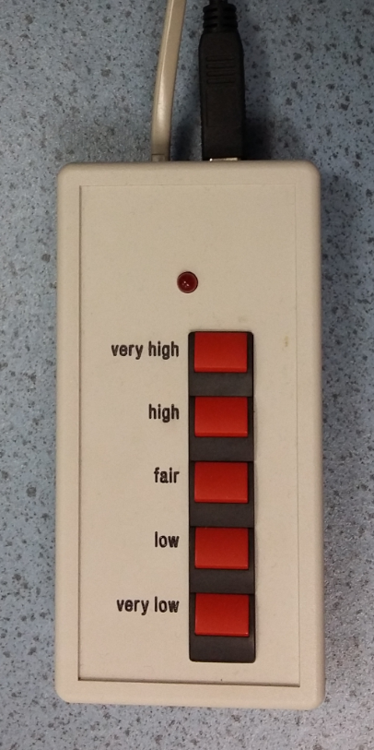
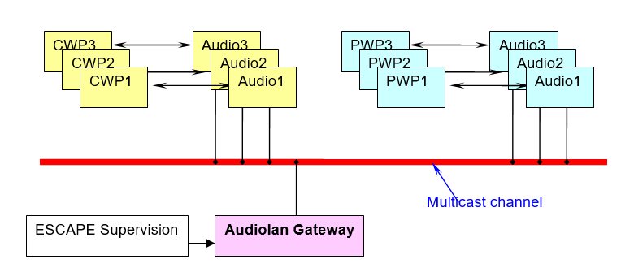
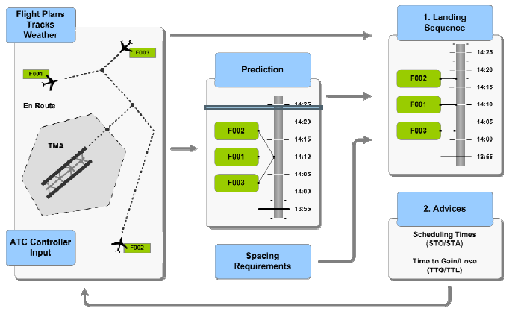
GROUND Tools - Extensions / Gateways
The architecture of ESCAPE allows the development of extensions of the simulator
Extension components
  AudioLAN
  ERGO
  Arrival Manager
Interoperability with other simulators
  Single Virtual Sky (SVS using MäkRTI)
  ED147 (using Pitch RTI technology)
Shadow mode
  Flight Plans
  Radar Tracks
Your extensions

Slide 32
ESCAPE Overview - Summary
This presentation is an overview of ESCAPE
Usage / Main features
Capacities
It includes a top level description of the main components:
Ground CORE system
Controller Working Position and ECHOES
AIR System
INFRA System
Datalink System
Ground Tools - Safety
Ground Tools - Extensions / Gateways
STORIA System - Recording and Analysis
IPAS System
…

Slide 33
STORIA System - Recording and Analysis
STORIA is the Software Tool for Online Recording and Interactive Analysis.
It is composed of:
STORIA CORBA COMPONENT (SCC), responsible for the catching and recording of events occurring during the simulation in XML format,
STORIA ANALYSIS TOOL (SAT), a java portable replay and analysis software.
The STORIA CORBA COMPONENT:
records the simulations events in XML format,
gathers the static data defining the simulation and runtime events.
The SAT COMPONENT:
Display the XML file with graphical representation
Enables precise events analysis
Enables replay of a run

Slide 34
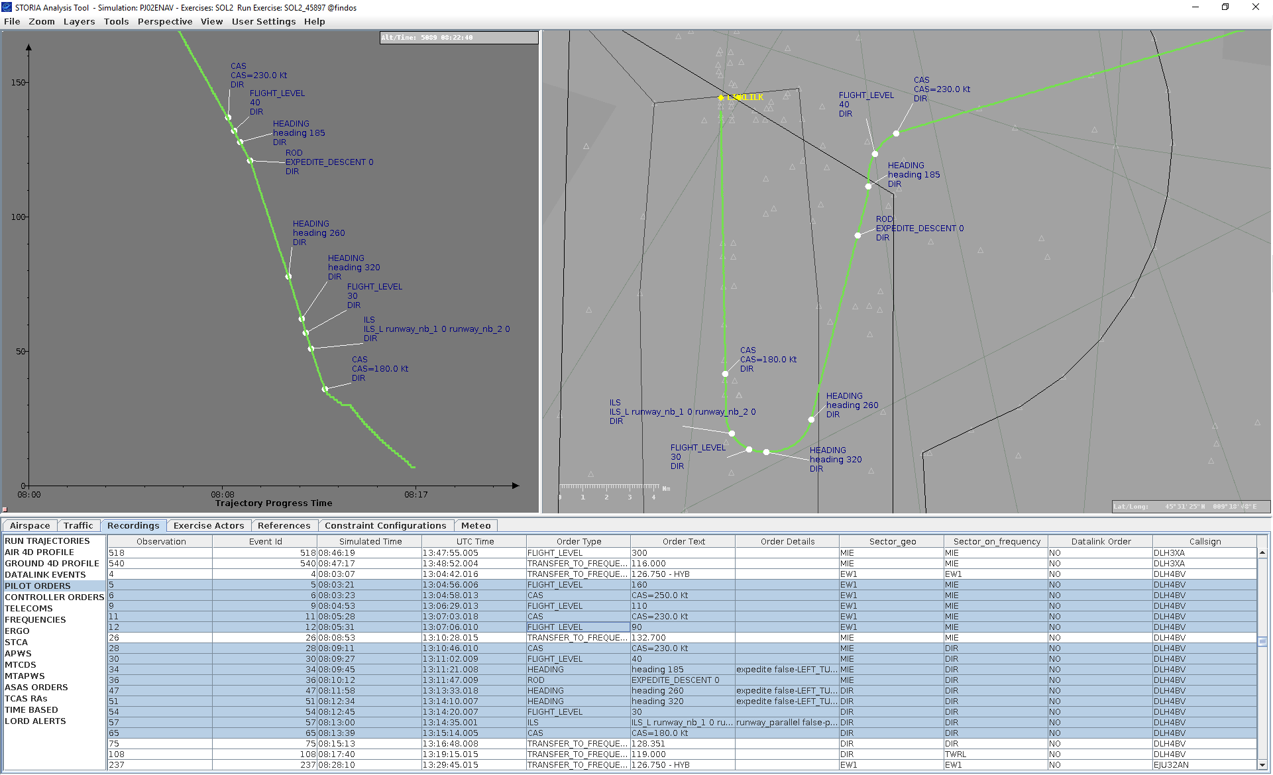
STORIA System - Recording and Analysis

Slide 35
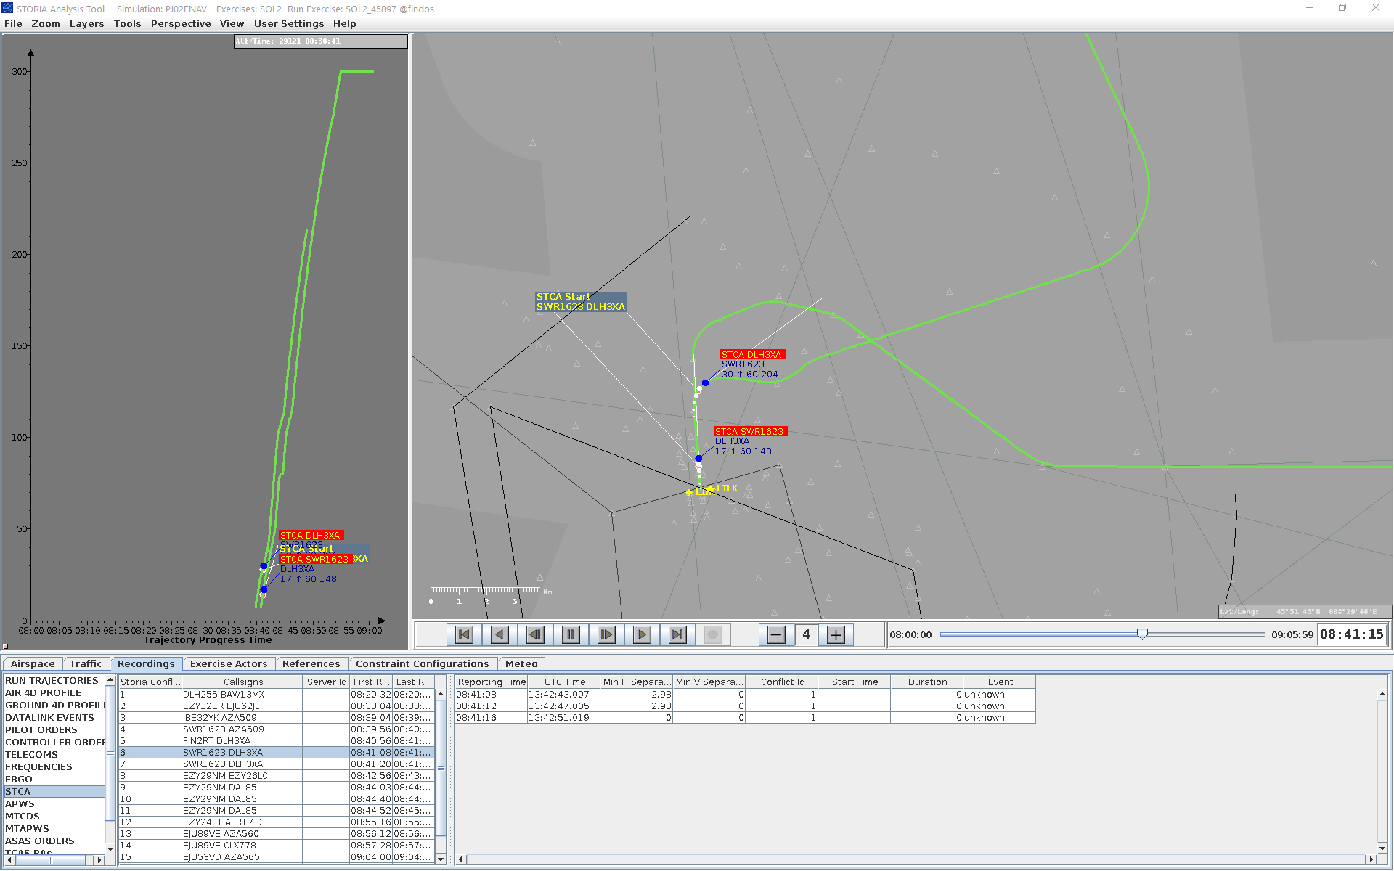
STORIA System - Recording and Analysis

Slide 36
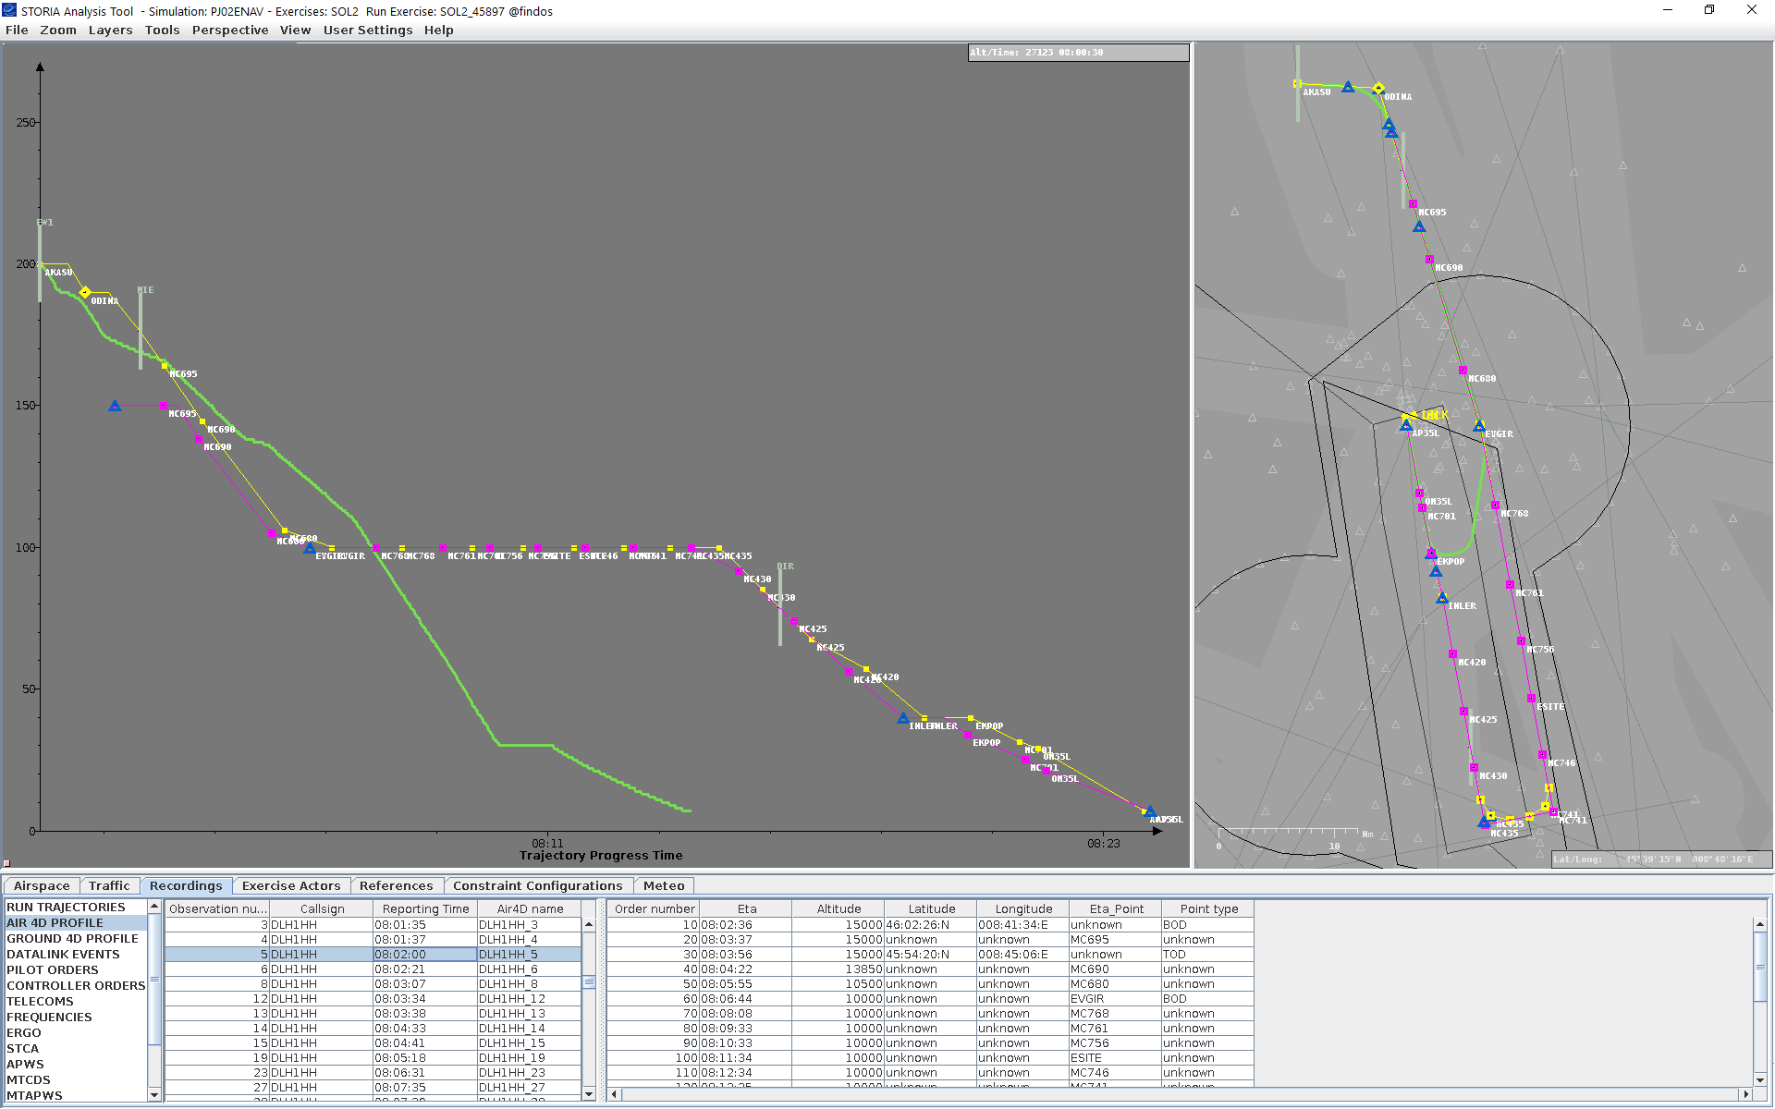
STORIA System - Recording and Analysis

Slide 37
ESCAPE Overview - Summary
This presentation is an overview of ESCAPE
Usage / Main features
Capacities
It includes a top level description of the main components:
Ground CORE system
Controller Working Position and ECHOES
AIR System
INFRA System
Datalink System
Ground Tools - Safety
Ground Tools - Extensions / Gateways
STORIA System - Recording and Analysis
IPAS System
…

Slide 38
IPAS System – data preparation
IPAS is the Integrated data Preparation and Analysis System
Main functionalities are:
The organization in domains (Airspace, Traffic, Constraint, Architecture, Meteo) including domain management (dataset)
Tabular editor concept
Exercise checking and delivery
Profile analysis
Traffic analysis (flows, conflicts, load, etc…)
Link with external tools (AIXM, AIRAC data, MS Excel)

Slide 39
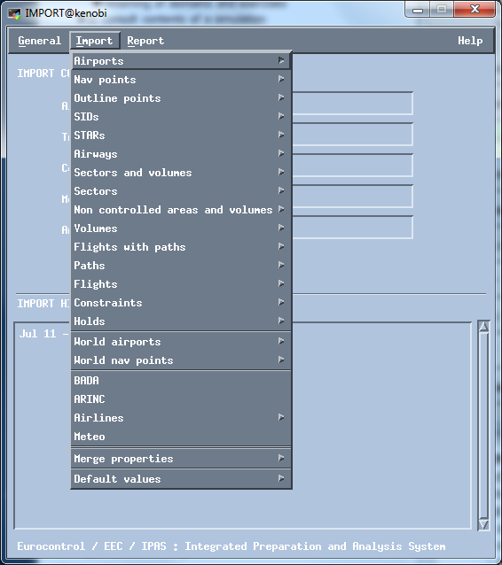
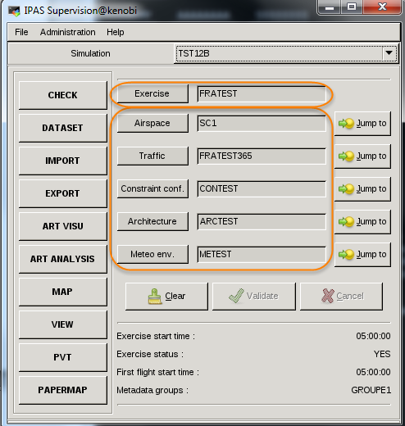
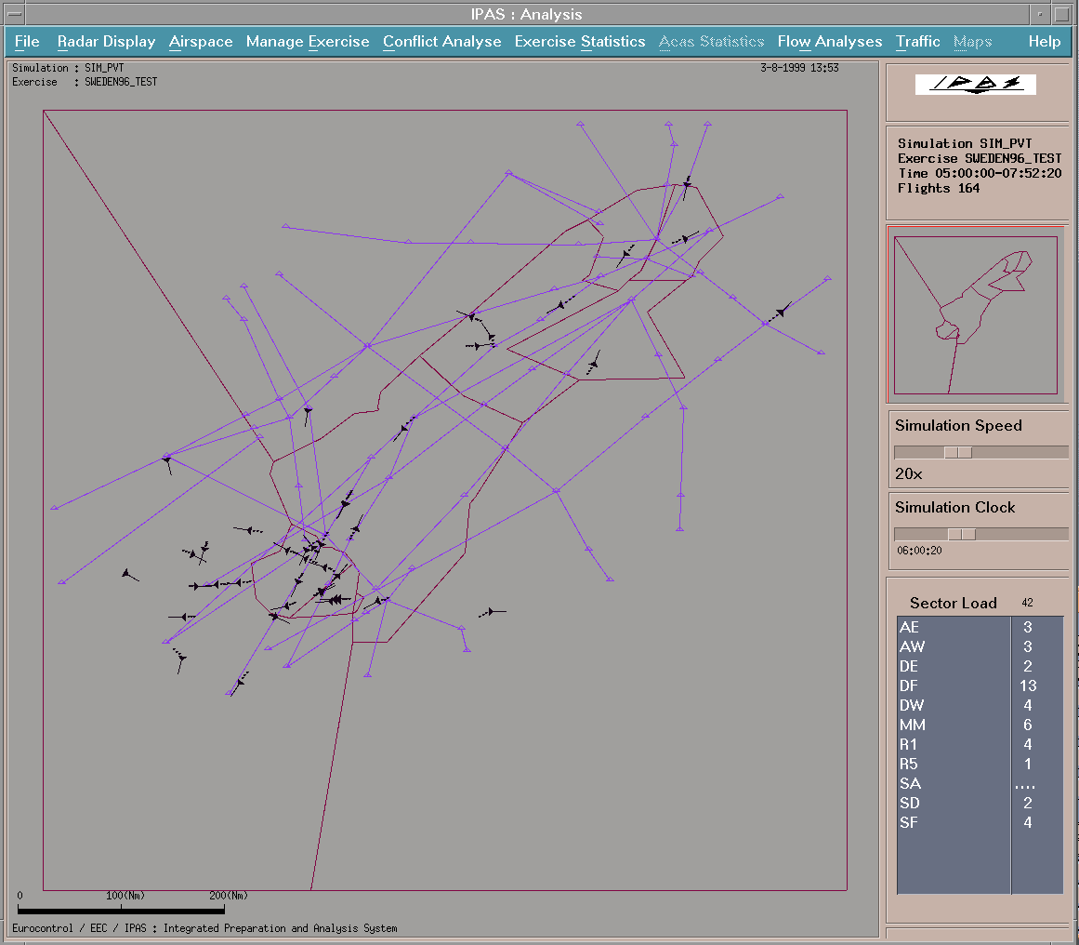
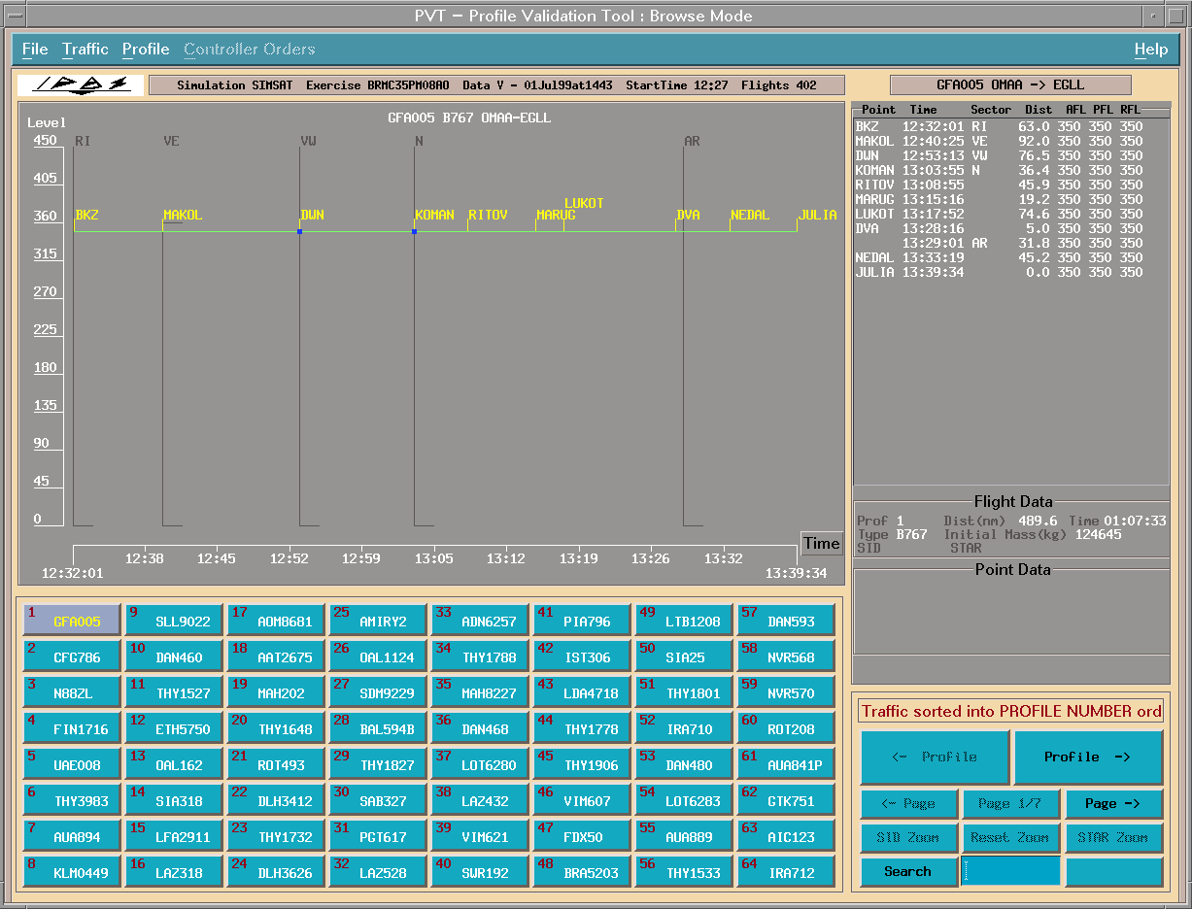
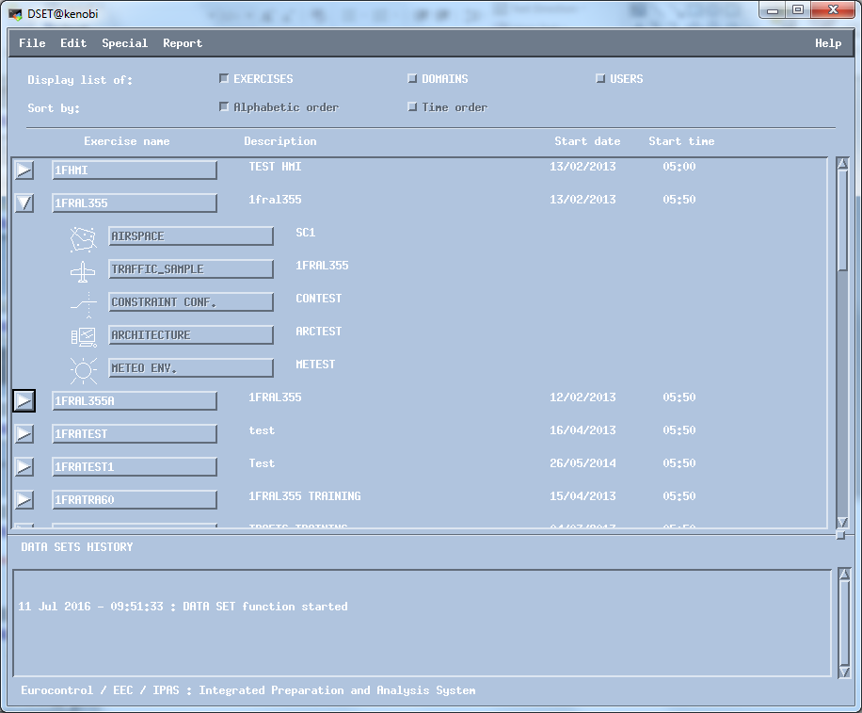
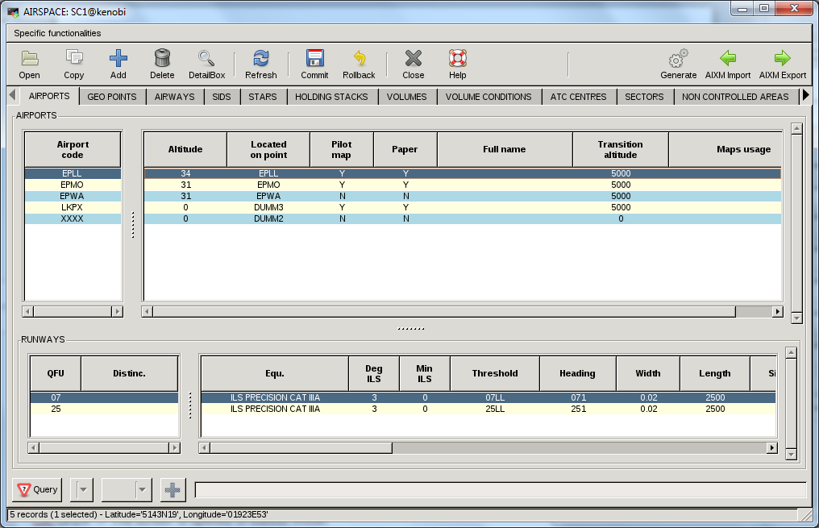
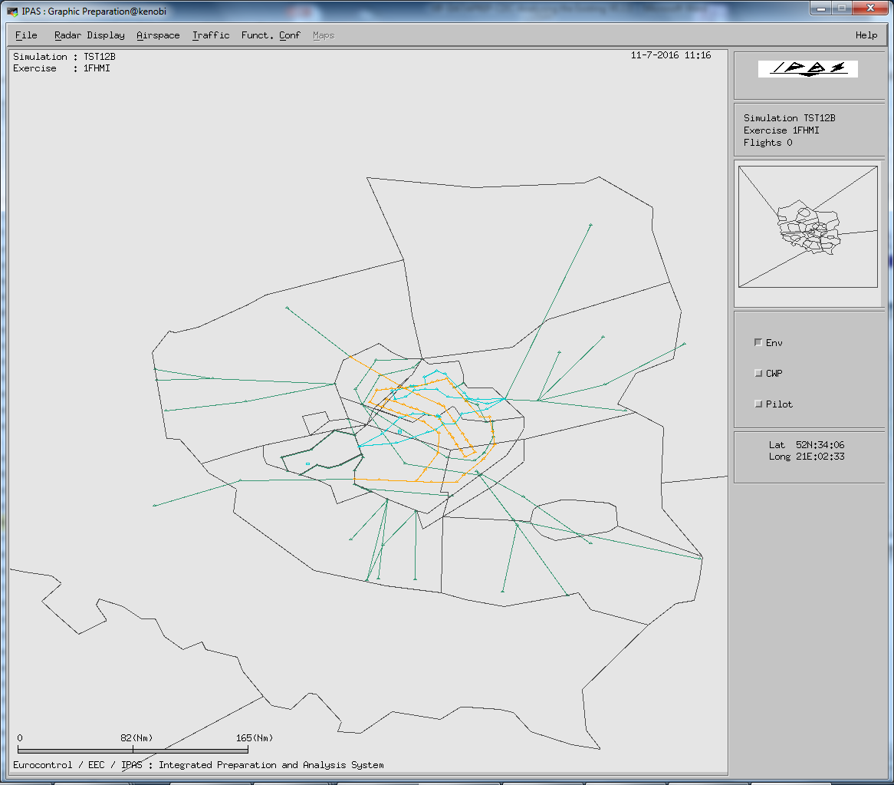
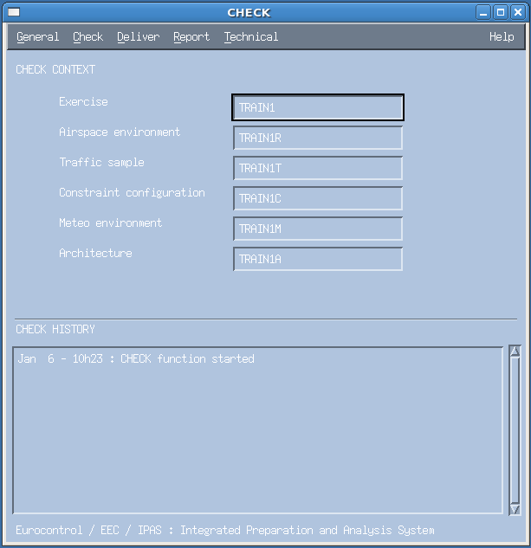
IPAS System – data preparation

Slide 40
ESCAPE Overview - Summary
This presentation is an overview of ESCAPE
Usage / Main features
Capacities
It includes a top level description of the main components:
Ground CORE system
Controller Working Position and ECHOES
AIR System
INFRA System
Datalink System
Ground Tools - Safety
Ground Tools - Extensions / Gateways
STORIA System - Recording and Analysis
IPAS System
Next Generation tools

Slide 41
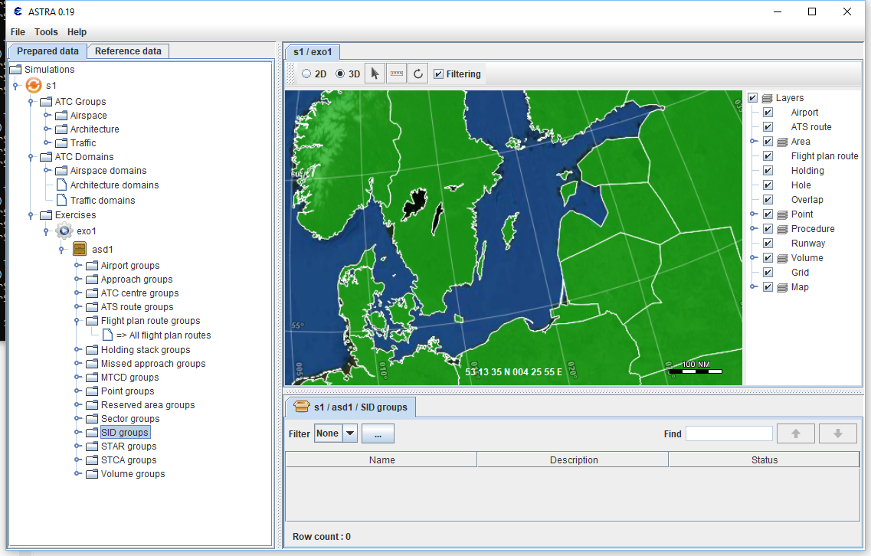
ASTRA System – next generation preparation tool

Slide 42
ESCAPE Overview
Thank you for using ESCAPE
Any questions?

