Slide 1
ESCAPE Light Training – STC
ESCAPE Light – Survival kit
Philippe BOUCHAUDON
ATM Simulator Specialist
Created: 21st of July 2020
Last update:

Slide 2
ESCAPE Light – Survival KIT
This document is a “Survival KIT” gathering many:
How to use: basic instruction
FAQs
Troubleshooting
recurrent questions
It will provide some indications / entry points, but it is not fully detailed.
Audience is supposed to be familiar with:
ESCAPE / ESCAPE Light
Linux (RHEL/CentOS 6.8 or 7.7)
SQL Plus
GNOME
…

Slide 3
ESCAPE Light – Survival kit
How to use

Slide 4
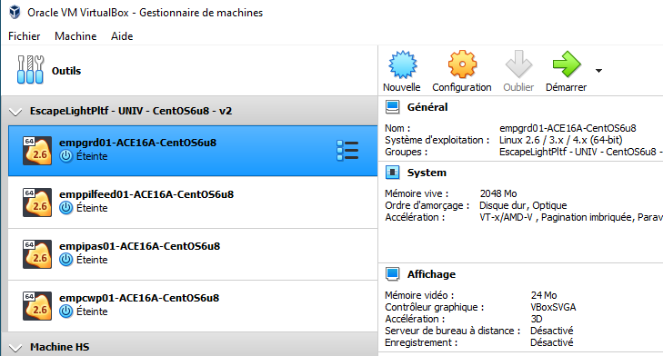
ESCAPE Light – Starting IPAS
In order to start IPAS:
Start VirtualBox
Start empgrd01
Start empipas01

Slide 5
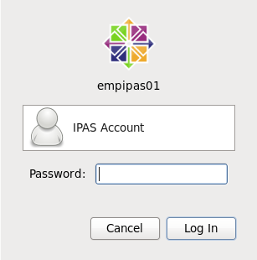
ESCAPE Light – Starting IPAS
In order to start IPAS:
Log using IPAS account (ope)
Be aware of the keyboard used

Slide 6
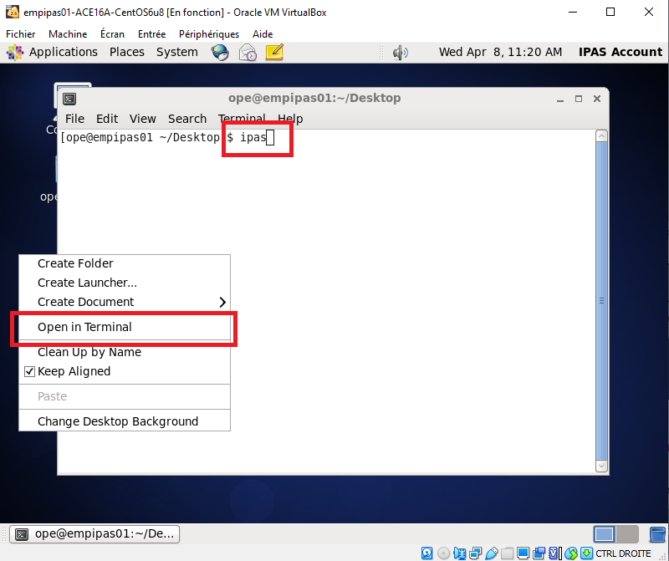
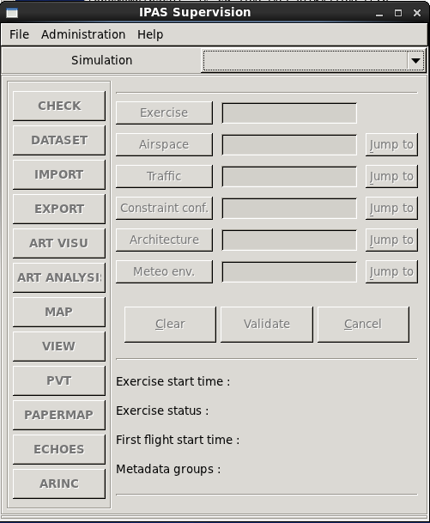
ESCAPE Light – Starting IPAS
Once logged:
Right Click on the background to open a terminal
Type “ipas” and return

Slide 7
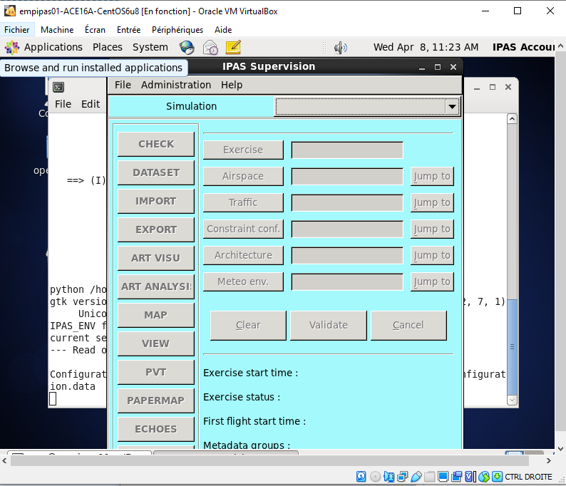
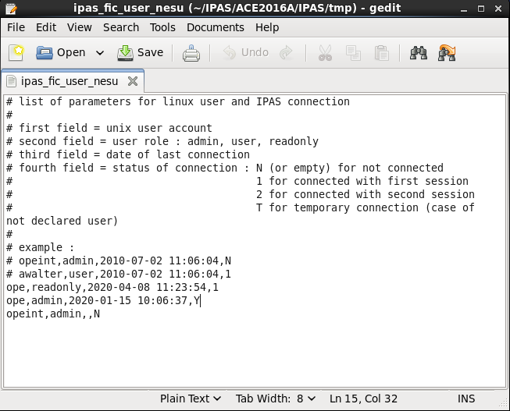
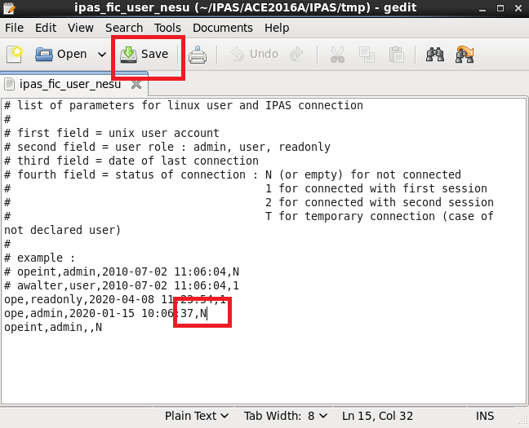
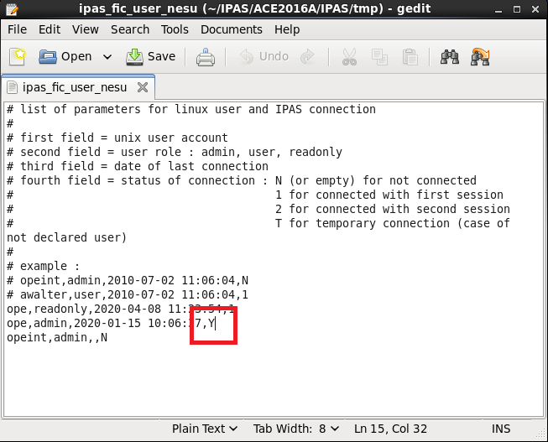
ESCAPE Light – IPAS in read only
IPAS background is “blue”: IPAS is in read-only
Open a terminal (right click in background)
Type the following commands:
cd
cd IPAS/ACE2016A/IPAS/tmp
gedit ipas_fic_user_nesu
Change the « Y » with a « N »
Save the file
Restart IPAS (grey background)

Slide 8
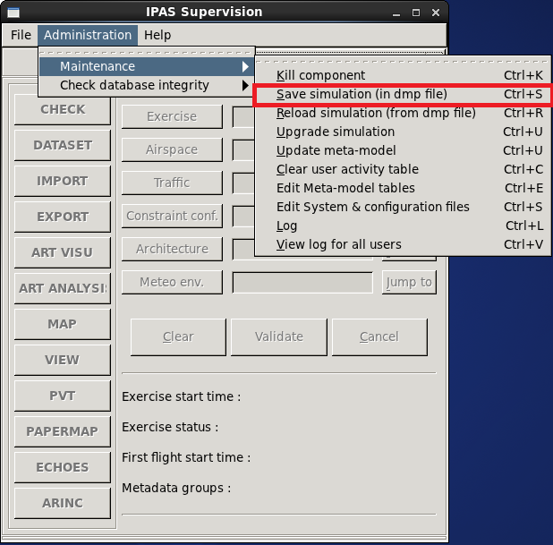
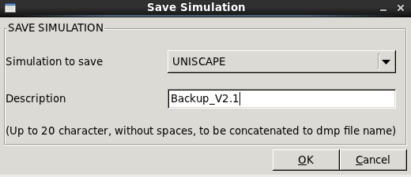
ESCAPE Light – Simulation backup
Start IPAS and BEFORE selecting a simulation:
select “Administration” menu
then “Maintenance”
then “Save simulation (in dmp file)”
Select the simulation and add a relevant description
Click on OK
The backup is located in:
/home/ope/SAVED_SIMUL/UNISCAPE
The directory shall have been previously created

Slide 9
ESCAPE Light – Starting ESCAPE runtime
To start ESCAPE:
Start VirtualBox
Start empgrd01
Start emppilfeed01
Start empcwp01

Slide 10
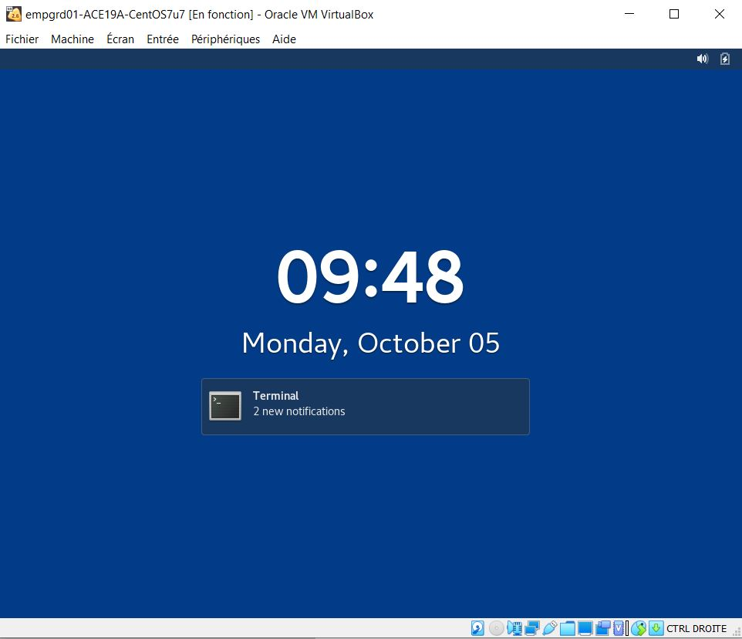
ESCAPE Light – Starting ESCAPE runtime
Remove ScreenSaver:
Click on the screen and maintain button
Move the mouse upwards
Release the mouse button

Slide 11
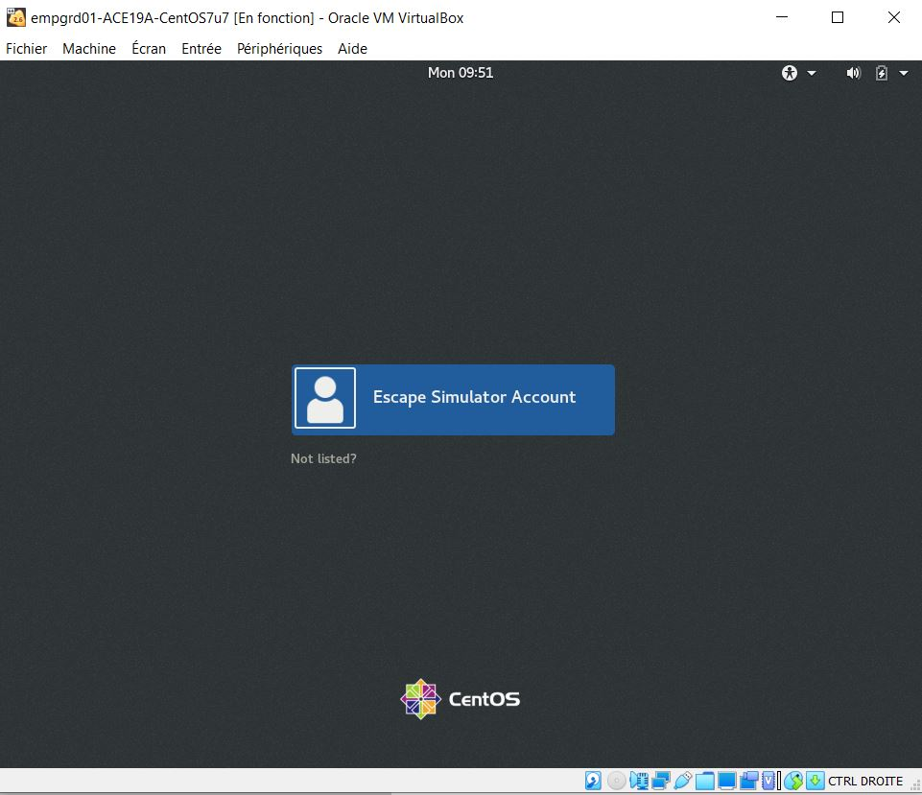
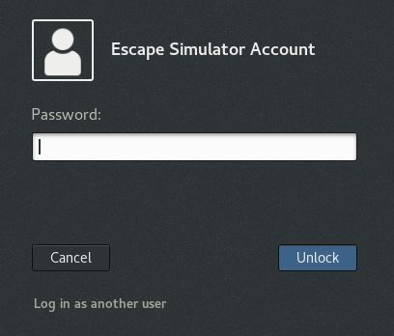
ESCAPE Light – Starting ESCAPE runtime
To start ESCAPE:
Log using IPAS account (ope)
Be aware of the keyboard used

Slide 12
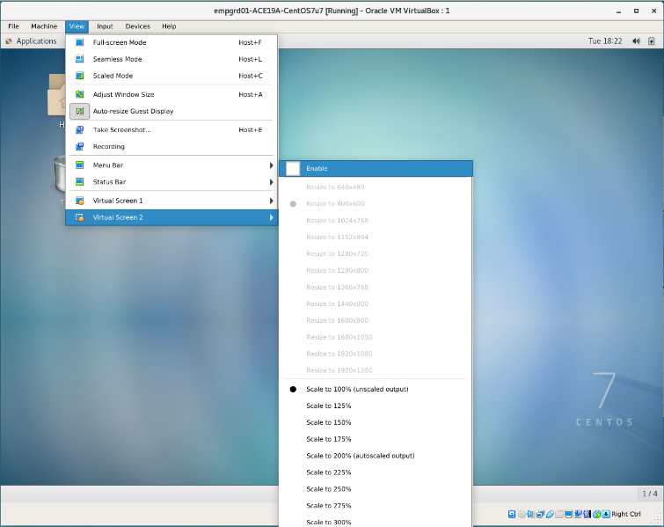
ESCAPE Light – Enabling second display
On emppilfeed01:
Second Virtual screen may have to be enabled
Optimal resolutions:
Virtual Screen 1: 1680x1050
Virtual Screen 2: 1920x1080 (Full HD)
On empcwp01:
Optimal resolutions:
Virtual Screen: 1920x1080 (Full HD)

Slide 13
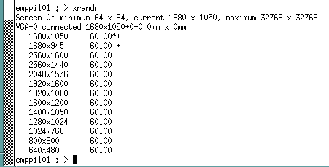
ESCAPE Light – Display resolution
On all machines
To know the display resolution type the command:
xrandr
The resolution followed by a “*” is the current one.

Slide 14
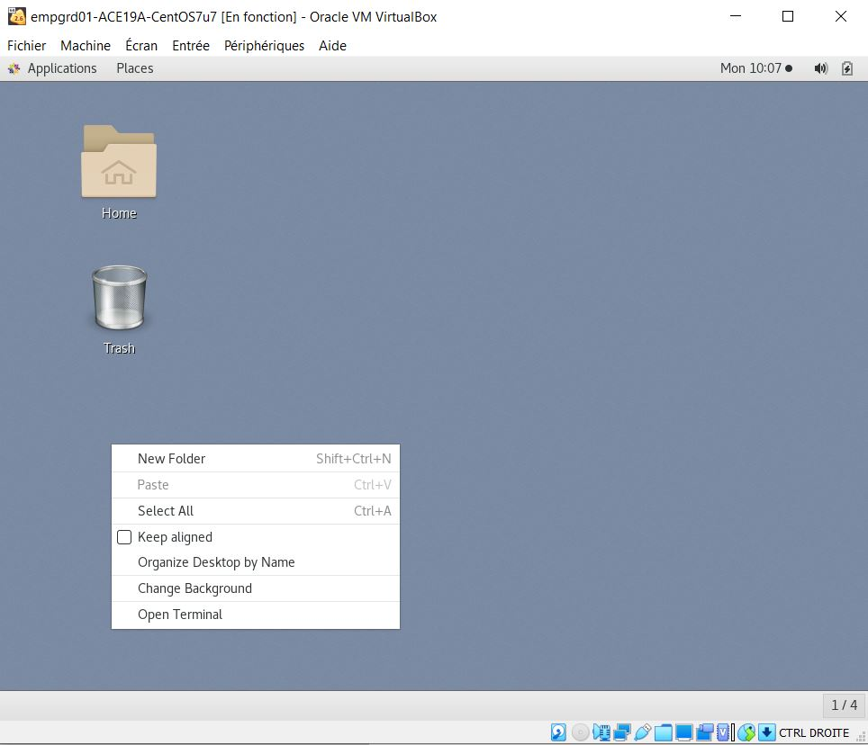
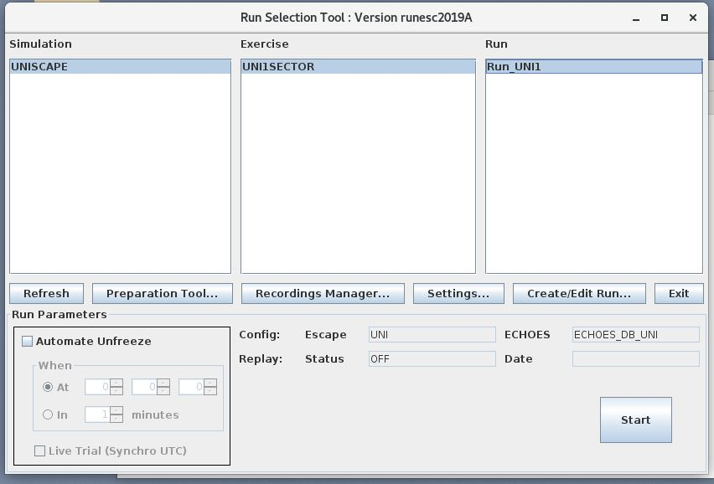
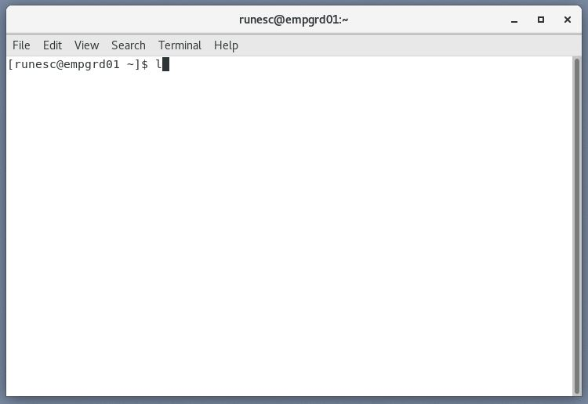
ESCAPE Light – Starting ESCAPE runtime
Once logged:
Right Click on the background to open a terminal
Type “l” and return
Select
UNISCAPE
UNI1SECTOR
Run_UNI1
Click on Start button

Slide 15
ESCAPE Light – Survival kit
Troubleshooting

Slide 16
ESCAPE Light – ODS License
ODS Licenses delivered during training sessions expired on the 30th of June 2022.
The file “license.dat”
located in “/opt/licenses/ods_toolbox”
Shall be replaced by a valid one
This shall be done on all hosts (CWP, PWP, IPAS and GRD)

Slide 17
ESCAPE Light – ORACLE user expiry date
The Oracle user created to host the IPAS data has an expiry date
Approximately 6 months from end of May 2020.
Thus during November many accounts may expire

Slide 18
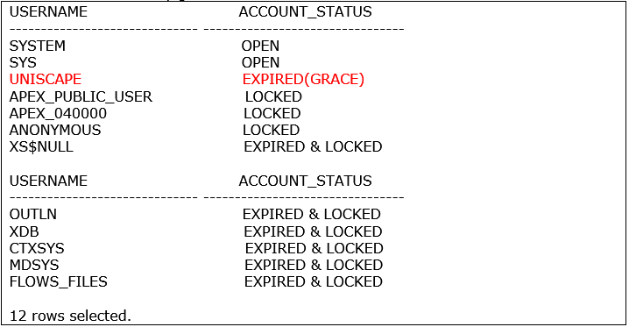
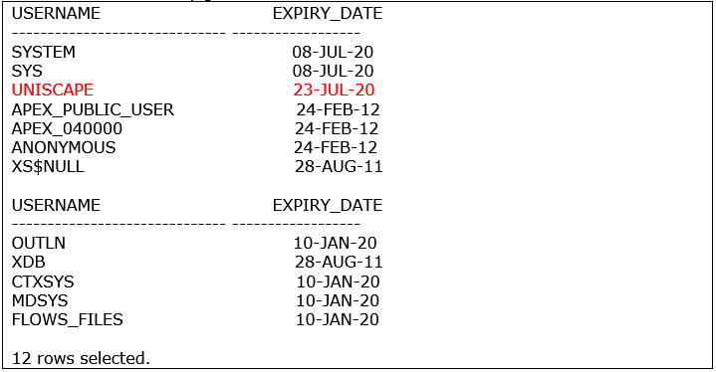
ESCAPE Light – ORACLE user expiry date
Diagnosis
Log on ipas machine and open a terminal
Change to root account (root password required) su –
From root account, change to oracle account (no password required) su – oracle
When connected to Oracle account, enter sqlplus command environment sqlplus /nolog
Connect as database admin (no password required) connect / as SYSDBA
Check status of the account SELECT username, account_status FROM dba_users;
Check expiry_date of the account SELECT username, expiry_date FROM dba_users;

Slide 19
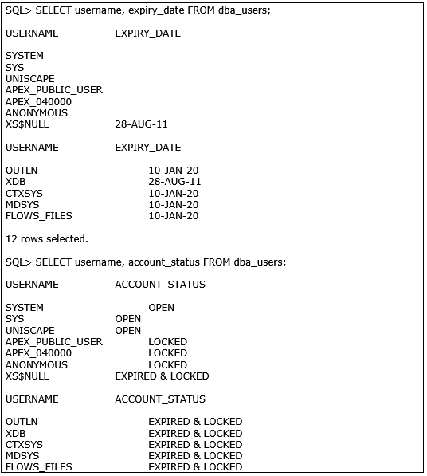
ESCAPE Light – ORACLE user expiry date
Correction (in continuity with previous slide)
Rewrite the password ALTER USER UNISCAPE IDENTIFIED BY ipas0;
Unlock account ALTER USER UNISCAPE ACCOUNT UNLOCK;
Unlimit password life time ALTER PROFILE DEFAULT LIMIT PASSWORD_LIFE_TIME UNLIMITED;
From this step, it is possible to restart the diagnosis SELECT username, account_status FROM dba_users; SELECT username, expiry_date FROM dba_users;
Exit SQL Plus exit

Slide 20
ESCAPE Light – Token server
Symptom is: any runs can start. Problem can be due to “not cleaned” tokens
Analysis: on ground machine (empgrd01)
cd /home/runesc/token_server ls -l
This directory shall contain only the “config.txt” file if no simulations are running.
-rw-r--r-- 1 runesc simulation 109 May 12 15:42 config.txt
-rw-r--r-- 1 runesc simulation 18 Apr 23 11:09 token_1
-rw-r--r-- 1 runesc simulation 22 May 26 10:32 token_2

Slide 21
ESCAPE Light – Token server
Symptom is: any runs can start. Problem can be due to “not cleaned” tokens
Corrections - 1:
Cleaning can be done with the removal of all “token_*” files.
Corrections - 2:
After cleaning the tokens, it may be also necessary to start the run with a “Light Deployment & Start” option.
To avoid the problem:
Do not forget to stop ESCAPE before shutting down virtual machines !

Slide 22
ESCAPE Light – Survival kit
Thank you for using ESCAPE
Any questions?

