Slide 1
Course 10775
Administering Microsoft® SQL Server® 2012 Databases
Notes:
This introduction module provides students with an overview of the course content materials and logistics for Course 10775A, Administering Microsoft SQL Server 2012 Databases.
Required materials
To teach this course, you need the following materials:
Course Handbook
Course Companion C
Trainer materials including:
Trainer Preparation Guide
Microsoft Office PowerPoint files for this course
Virtual machines for the course
Latest error logs for the course
Important It is recommended that you use PowerPoint 2007 or a later version to display the slides for this course. If you use PowerPoint Viewer or an earlier version of PowerPoint, all the features of the slides might not be displayed correctly.
Preparation tasks
To prepare for this course, you must follow and complete the tasks outlined in the Trainer Preparation Guide.
Presentation: 20 minutes

Slide 2


Slide 3
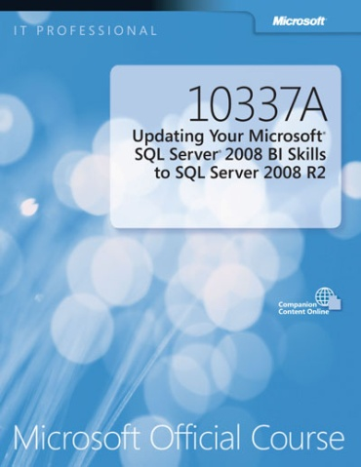

Course Material
Course Handbook
Course Companion Content on the http://www.microsoft.com/learning/companionmoc Site
A succinct classroom learning guide that provides critical technical information to optimize your
in-class learning experience.
Searchable, easy-to-navigate digital content with integrated premium
on-line resources designed to supplement the Course Handbook.
Student Course files required for the labs and demonstrations.
Module Content
Labs
Module Reviews and Takeaways
Lab Answer Keys
Supplemental Course Content
Student Course Files
http://www.microsoft.com/learning/
Notes:
Tell Students that the two critical course components are the Course Handbook and the Course Companion Content.
Mention that the Course Handbook is primary resource for in-class learning and they can use the Course Companion Content for additional reference outside the class.
Additional Information on the Course Handbook :
Course Handbook –The handbook enhances the learning experience through:
Lessons: Include various types of topics based on the content type to be taught: Lecture, Demonstration, Multimedia, and Discussion. Guide you through the learning objectives and provide the key points that are critical to the success of the in-class learning experience.
Labs: Provide a platform for students to apply the knowledge and skills learned in the module. The labs provide a real-world experience with scenario-driven exercises, tasks, and high-level steps.
Module Reviews and Takeaways: Provide improved on-the-job reference material that includes only the most effective and up-to-date troubleshooting tips and best practice recommendations our industry has to offer. This information helps students to recall and synthesize troubleshooting tips for the common issues as a way to boost knowledge/skills retention.
Lab Answer Keys: Provide step-by-step lab solution guidance at your finger tips when it’s needed. These are included in the appendix of the handbook.
Additional Information on the Course Companion Content:
Course Companion Content on the http://www.microsoft.com/learning/companionmoc Site. Searchable, easy-to-navigate digital content with integrated premium on-line resources designed to supplement the Course Handbook.
Modules: Include companion content, such as questions and answers, detailed demo steps and additional reading links, for each lesson. Additionally, they include Lab Review questions and answers and Module Reviews and Takeaways sections, which contain the review questions and answers, best practices, common issues and troubleshooting tips with answers, and real-world issues and scenarios with answers.
Resources: Include well-categorized additional resources that give you immediate access to the most up-to-date premium content on TechNet, MSDN, Microsoft Press
Student Course Files on the http://www.microsoft.com/learning/companionmoc Site : Include the Allfiles.exe , a self-extracting executable file that contains all the files required for the labs and demonstrations.
Note the Born to Learn Wiki is being created at the following location: http://go.microsoft.com/fwlink/?LinkID=237236 (you will need your MCT credentials to access this site)

Slide 4

Course Outline – Modules 1 - 10
Module 1: Introduction to SQL Server 2012 and Its Toolset
Module 2: Preparing Systems for SQL Server 2012
Module 3: Installing and Configuring SQL Server 2012
Module 4: Working with Databases
Module 5: Understanding SQL Server 2012 Recovery Models
Module 6: Backup of SQL Server 2012 Databases
Module 7: Restoring SQL Server 2012 Databases
Module 8: Importing and Exporting Data
Module 9: Authenticating and Authorizing Users
Module 10: Assigning Server and Database Roles

Slide 5
Course Outline – Modules 11 - 20
Module 11: Authorizing Users to Access Resources
Module 12: Auditing SQL Server 2012 Environments
Module 13: Automating SQL Server 2012 Management
Module 14: Configuring Security for SQL Server Agent
Module 15: Monitoring SQL Server 2012 with Alerts and Notifications
Module 16: Performing Ongoing Database Maintenance
Module 17: Tracing Access to SQL Server 2012
Module 18: Monitoring SQL Server 2012
Module 19: Managing Multiple Servers
Module 20: Troubleshooting Common SQL Server 2012 Administrative Issues

Slide 6
Virtual Machine Environment
Virtual machine | Used as:
10775A-MIA-SQL1 | Virtual machine for Modules 01 - 20
Note: Before the lab in each module, you must revert the virtual machines as per the instructions in D:\10775A_Labs\Revert.txt

Slide 7
Demonstration: Using Microsoft Hyper-V Server
Help the students to familiarize with the Hyper-V Server environment in which they will work to complete the course’s labs.
In this demonstration, you will learn how to:
Connect to Hyper-V Manager.
Connect to a virtual machine using the Virtual Machine Remote Control Client.
Revert the virtual machines.
Notes:
7
7

